Slide 1
Chapter 26 Networking

Slide 2
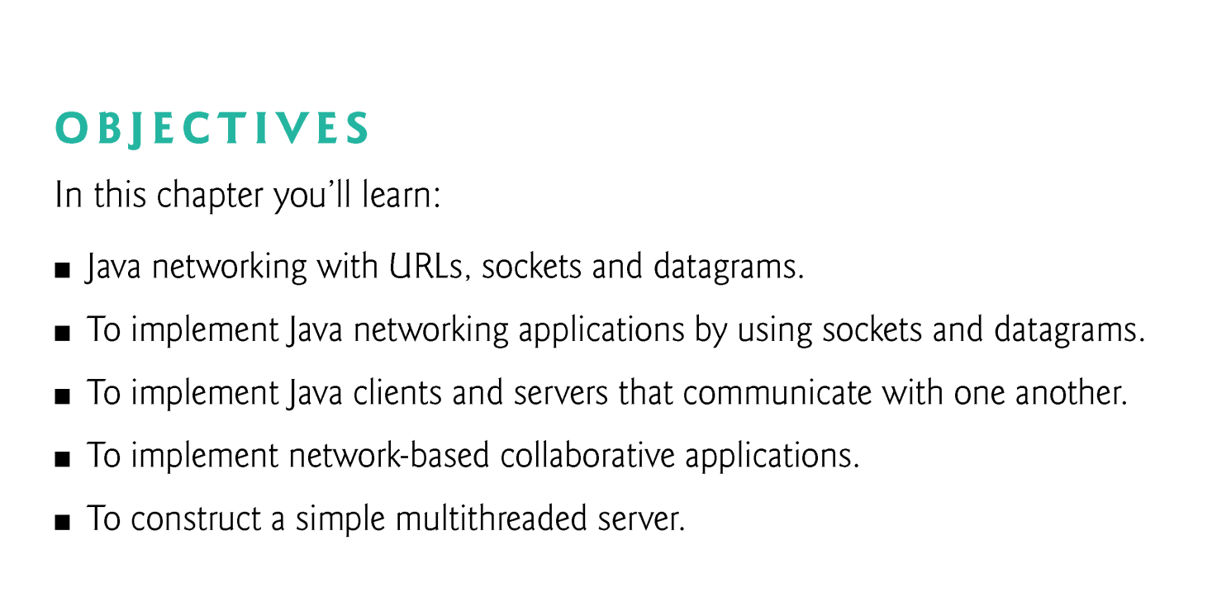

Slide 3
26.1 Introduction
package java.net
Stream-based communications that enable applications to view networking as streams of data.
Packet-based communications for transmitting individual packets of information—commonly used to transmit data images, audio and video over the Internet.
We focus on both sides of the client/server relationship.
The client requests /the server performs the action and responds to the client.

Slide 4
26.1 Introduction (cont.)
Socket-based(基于套接字） communications enable applications to view networking as if it were file I/O.
With stream sockets, a process establishes a connection to another process.
While the connection is in place, data flows between the processes in continuous streams.
Stream sockets are said to provide a connection-oriented service.
The protocol used for transmission is the popular TCP (Transmission Control Protocol).

Slide 5
26.1 Introduction (cont.)
With datagram sockets, individual packets of information are transmitted.
UDP—the User Datagram Protocol—is a connectionless service, and thus does not guarantee that packets arrive in any particular order.
Packets can even be lost or duplicated.

Slide 6
26.2 Manipulating URLs
HyperText Transfer Protocol (HTTP) forms the basis of the World Wide Web
uses URIs (Uniform Resource Identifiers) to identify data on the Internet.
URIs that specify the locations of documents are called URLs (Uniform Resource Locators).
AppletContext method showDocument causes the browser to access and display a resource.

Slide 7
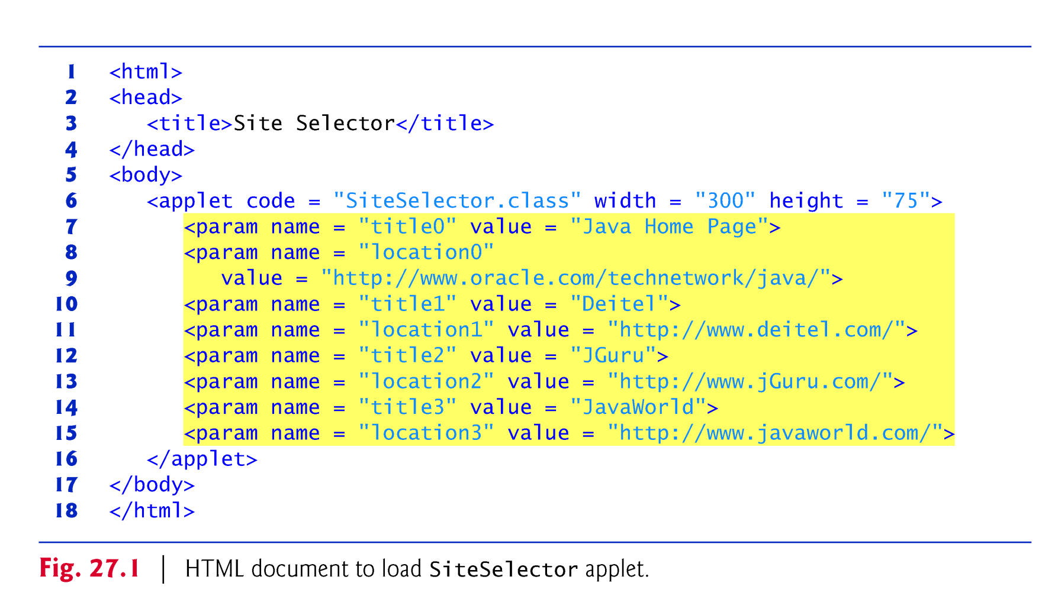

Slide 8
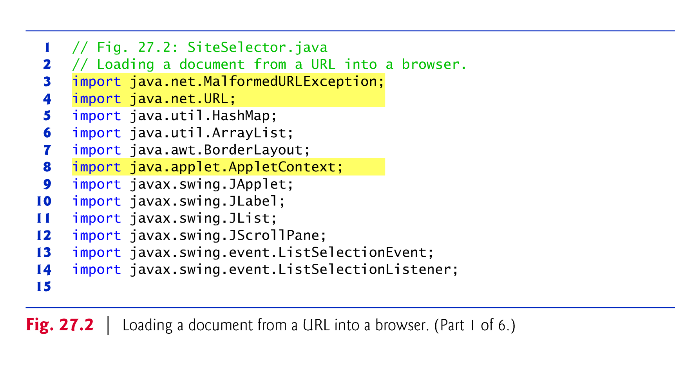

Slide 9
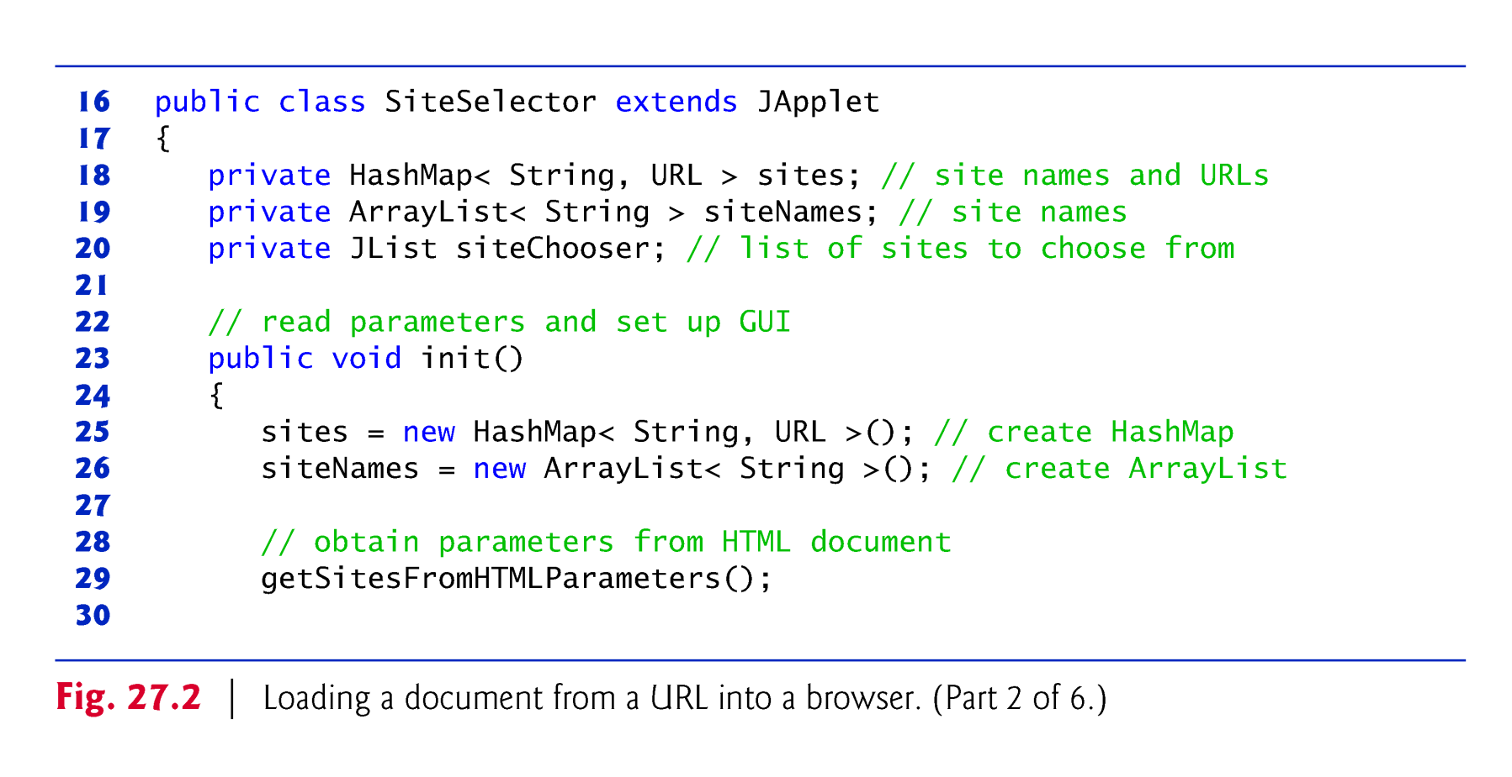

Slide 10
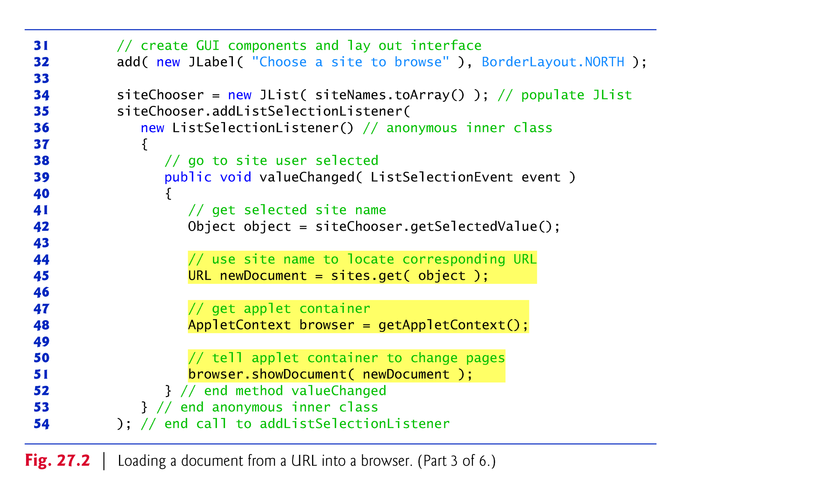

Slide 11
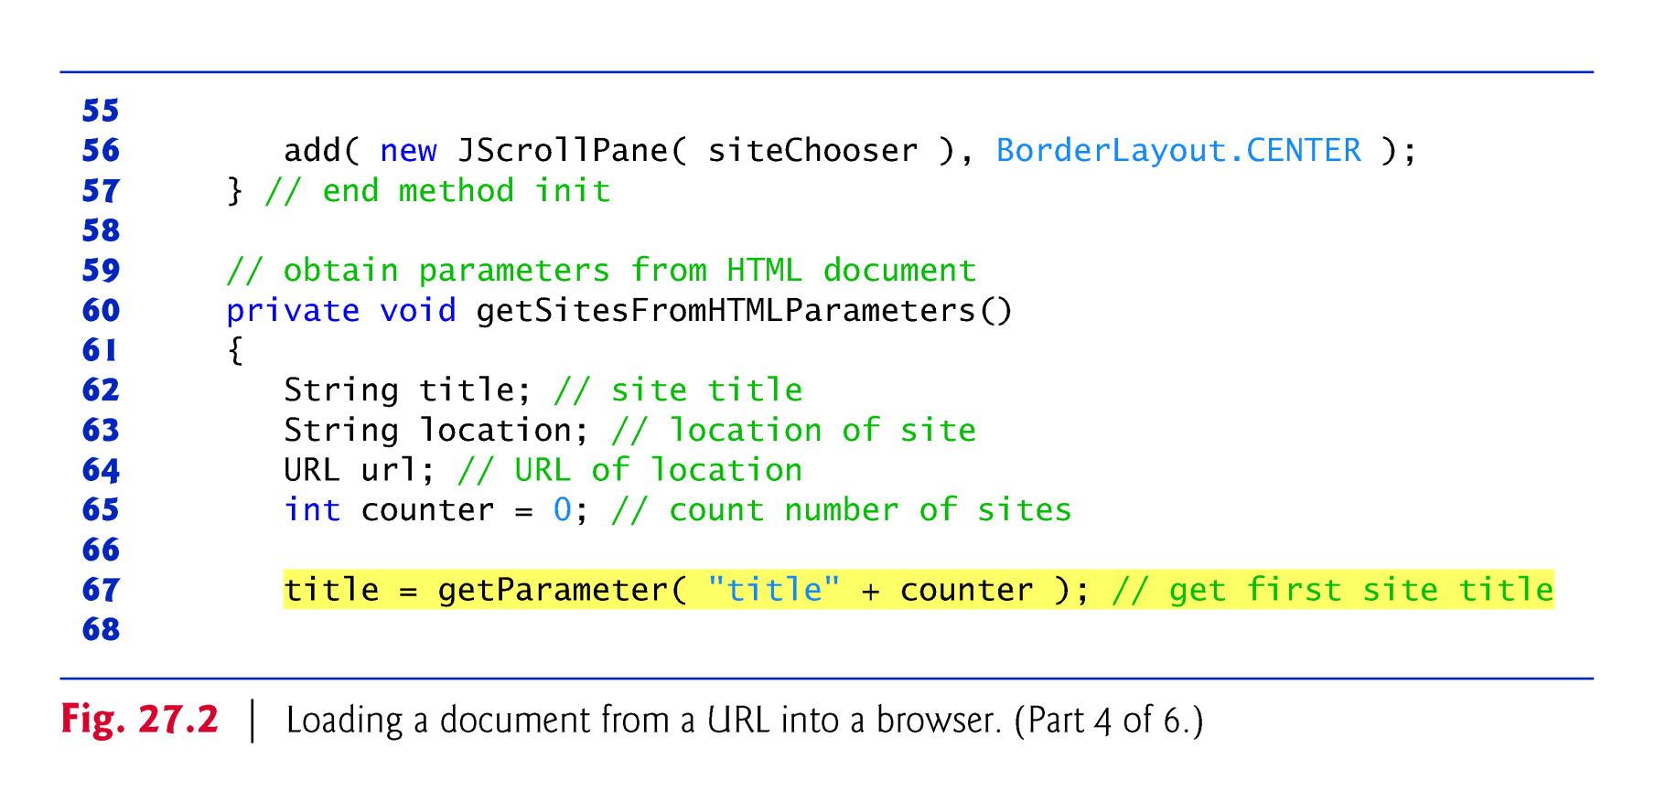

Slide 12
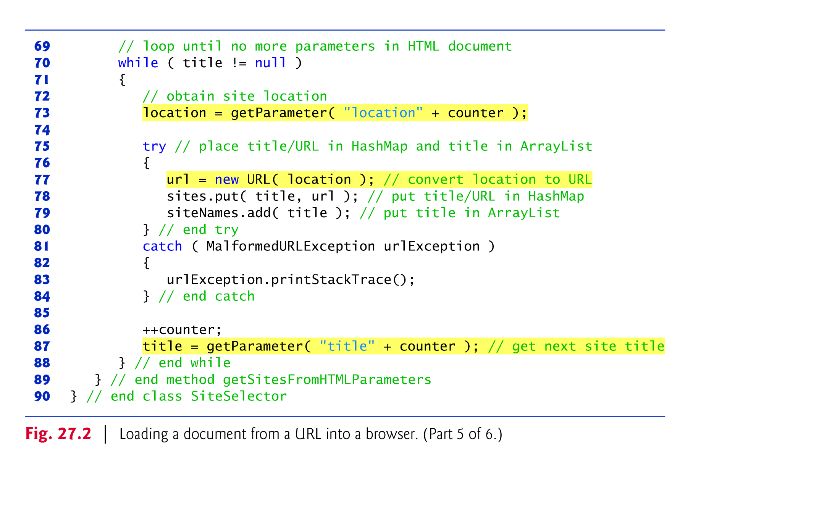

Slide 13
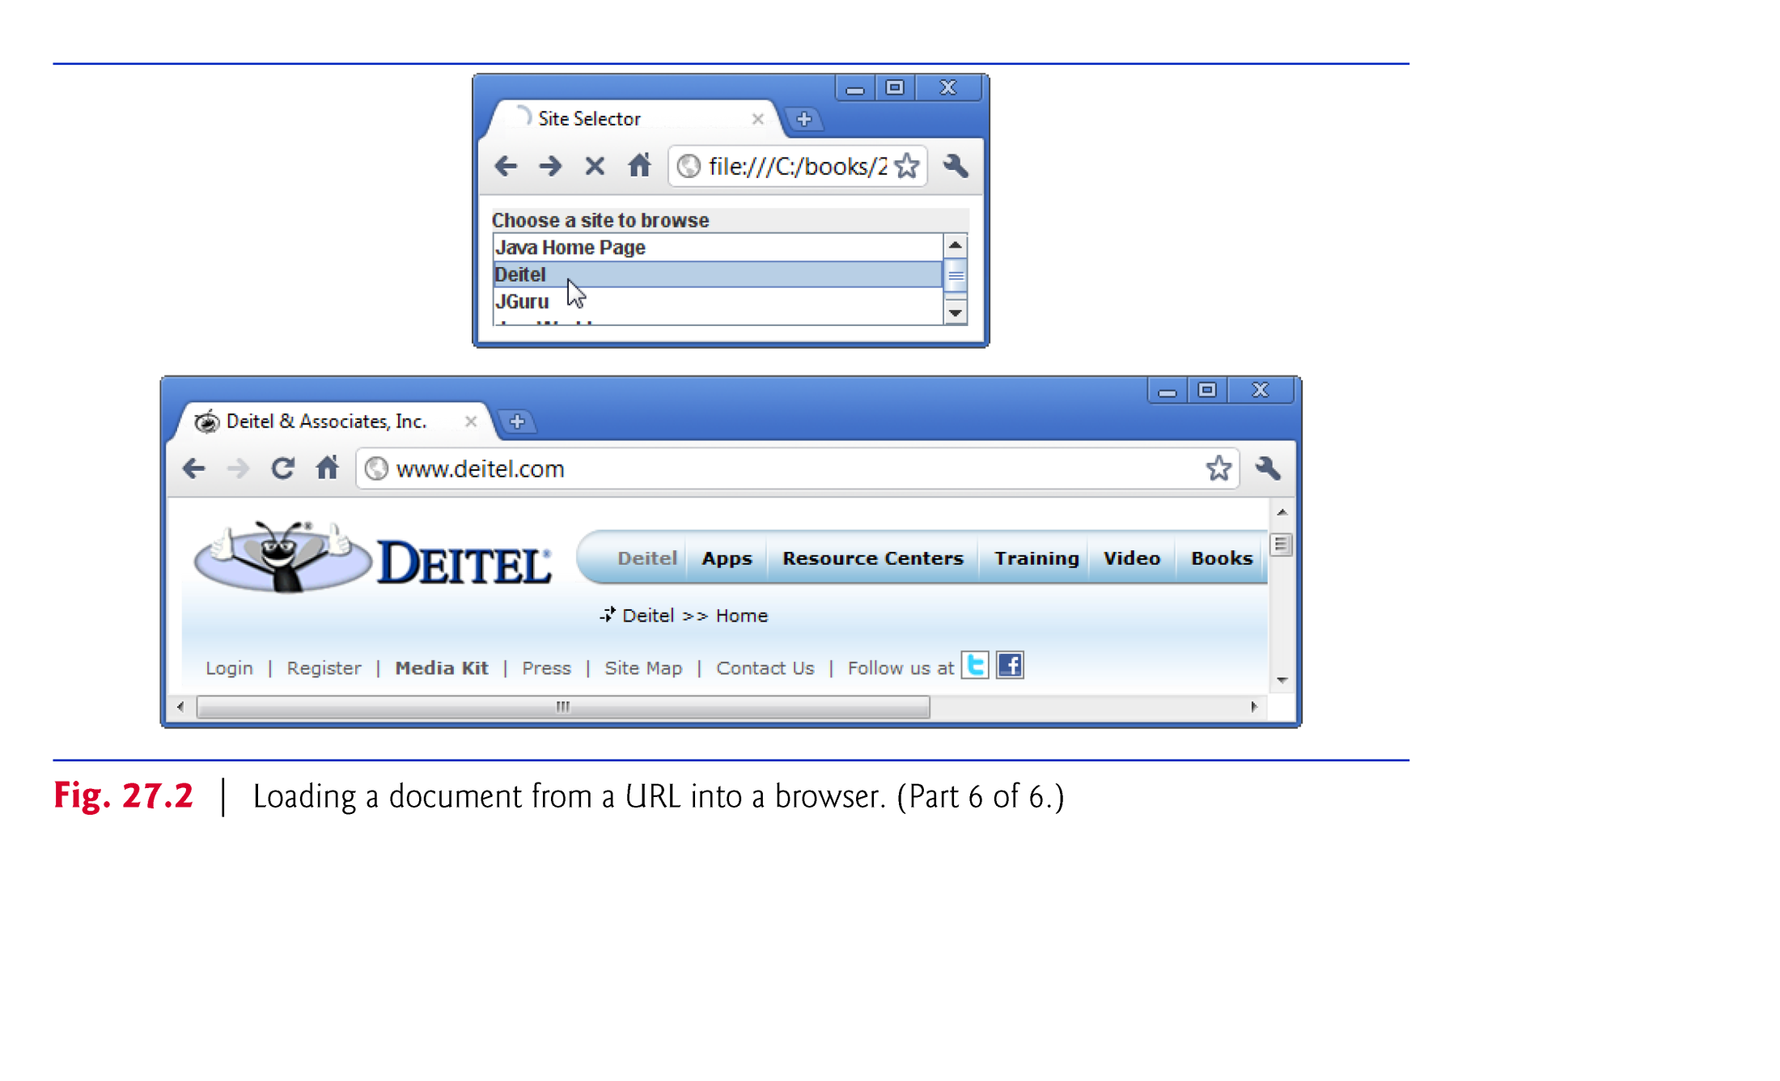

Slide 14
26.3 Reading a File on a Web Server
Swing GUI component JEditorPane (from package javax.swing) can display the contents of a file on a web server.
Class JEditorPane can render both plain text and XHTML-formatted text
this application acts as a simple web browser.
Can process HyperlinkEvents when the user clicks a hyperlink in the JEditorPane.

Slide 15
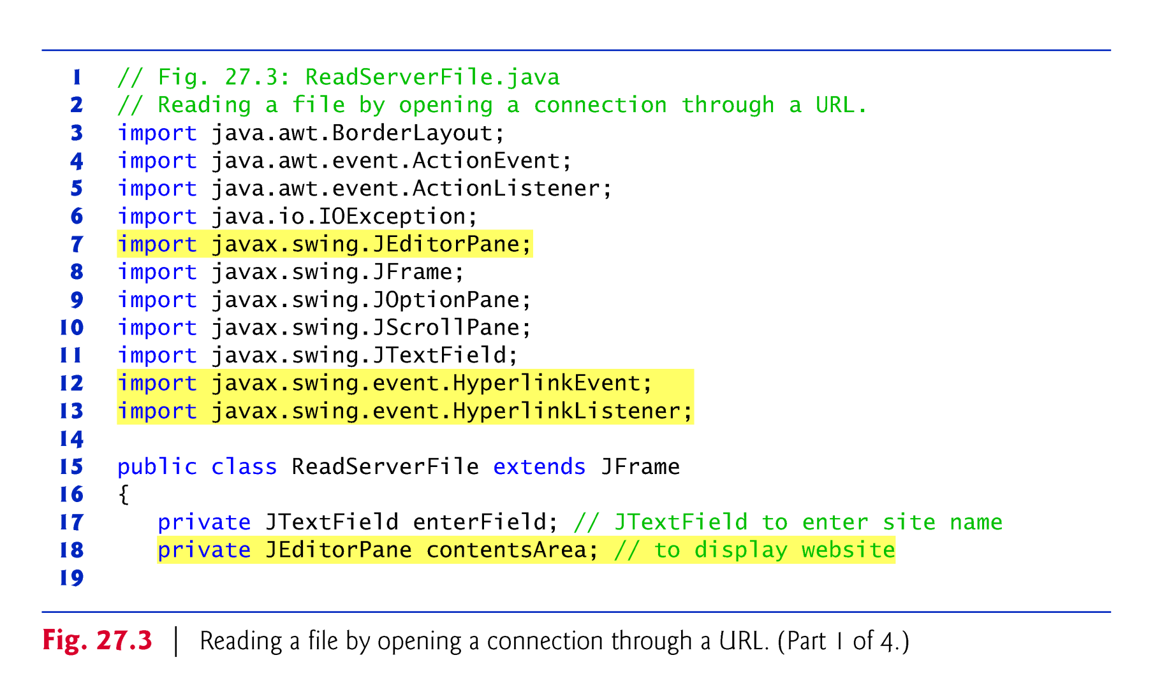

Slide 16
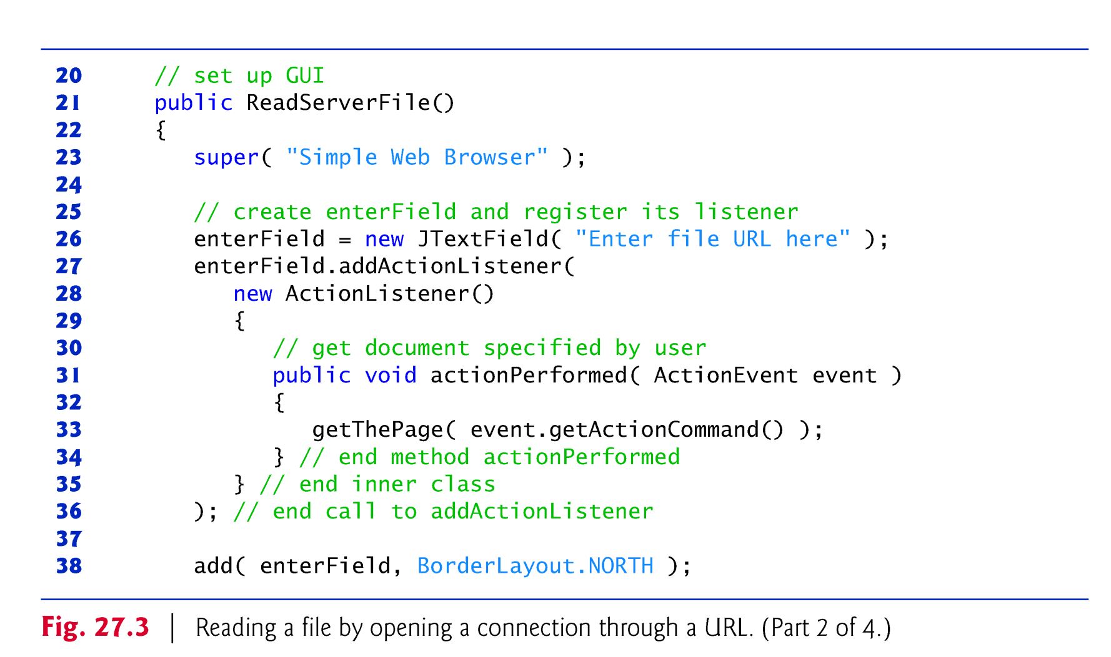

Slide 17
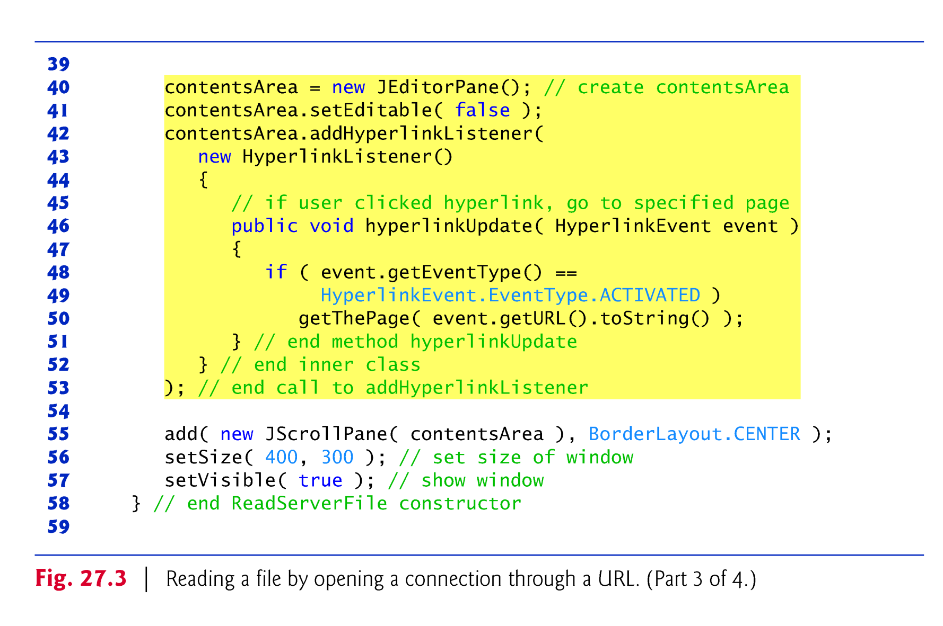

Slide 18
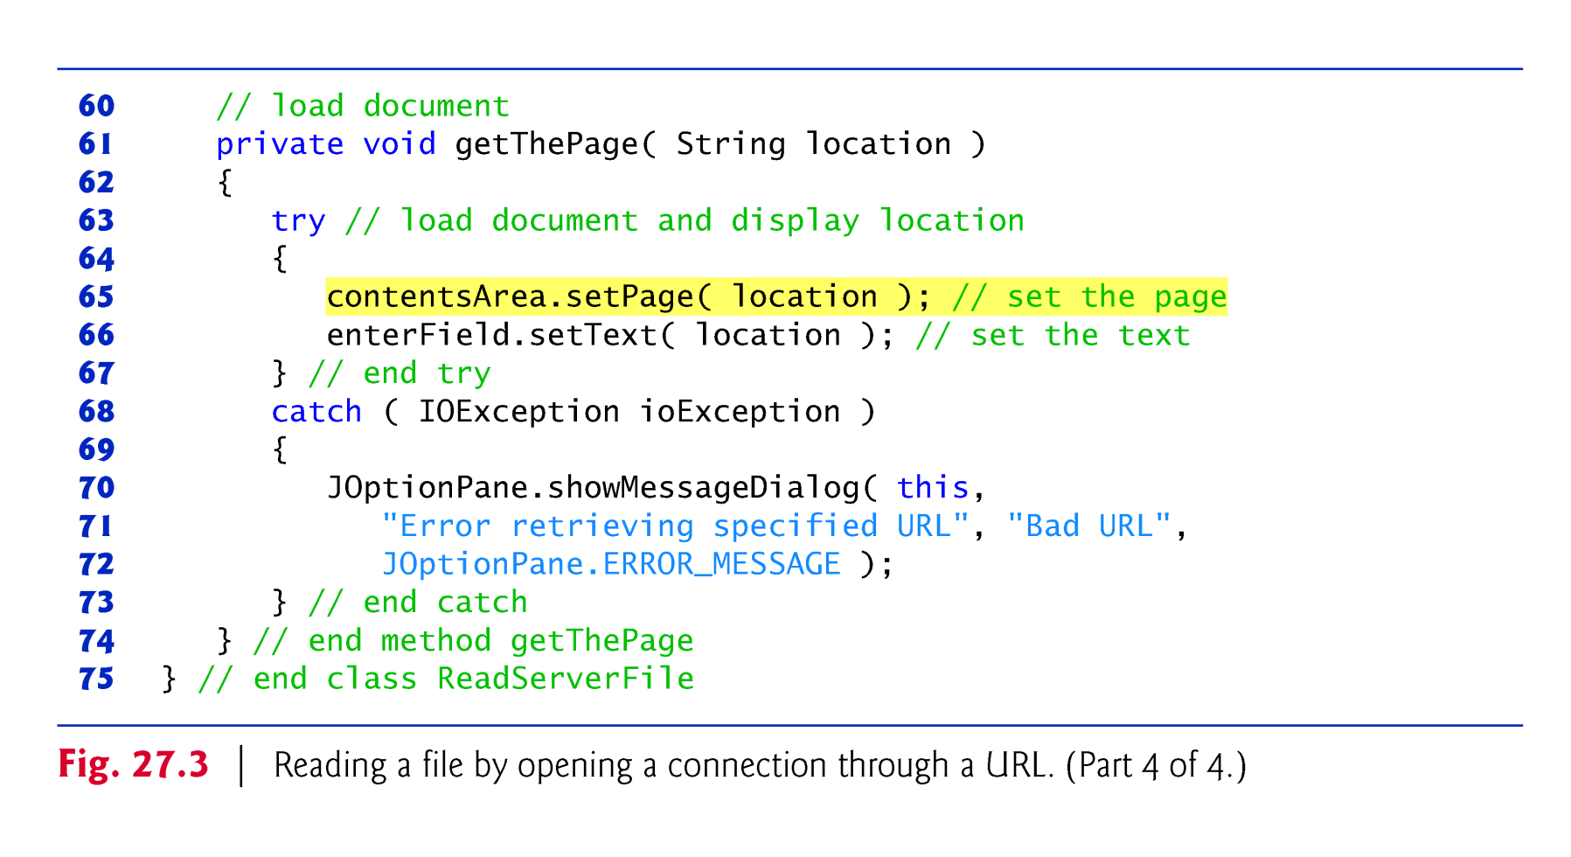

Slide 19
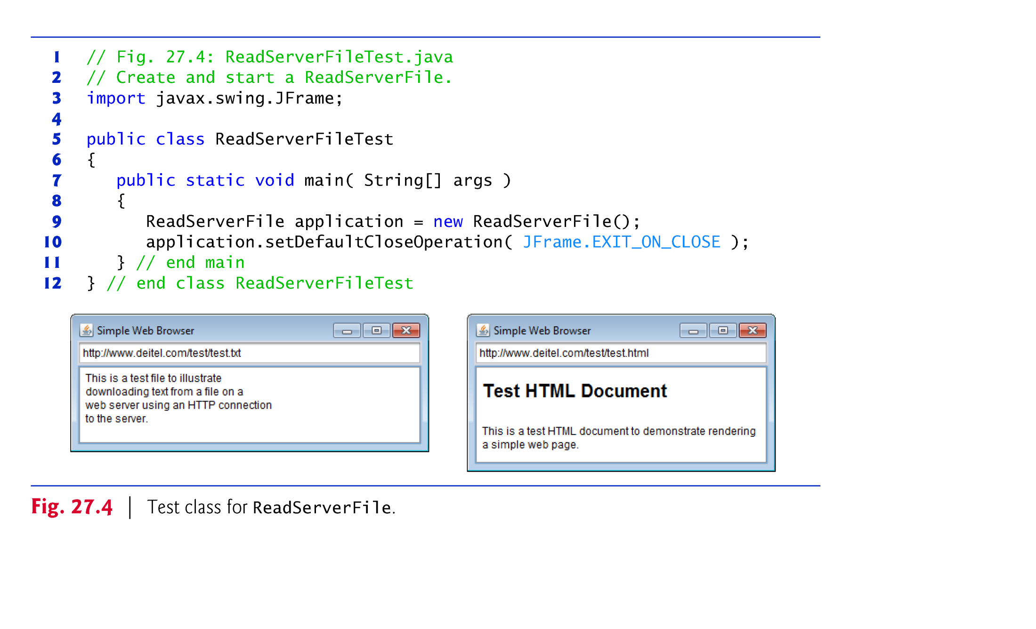

Slide 20
26.3 Reading a File on a Web Server (cont.)
JEditorPane method setPage downloads a document and displays it.
If there is an error, throws an IOException.
if an invalid URL, throws a MalformedURLException.
If a JEditorPane contains an XHTML document and the user clicks a hyperlink, the JEditorPane generates a HyperlinkEvent (package javax.swing.event) and notifies all registered HyperlinkListeners (package javax.swing.event) of that event.
When a HyperlinkEvent occurs, the program calls method hyperlinkUpdate on the registered listener(s).

Slide 21
26.3 Reading a File on a Web Server (cont.)
HyperlinkEvent method getEventType returns the type of the HyperlinkEvent.
HyperlinkEvent nested class EventType declares three static EventType objects
ACTIVATED indicates that the user clicked a hyperlink to change web pages
ENTERED indicates that the user moved the mouse over a hyperlink
EXITED indicates that the user moved the mouse away from a hyperlink
HyperlinkEvent method getURL obtains the URL represented by the hyperlink.

Slide 22
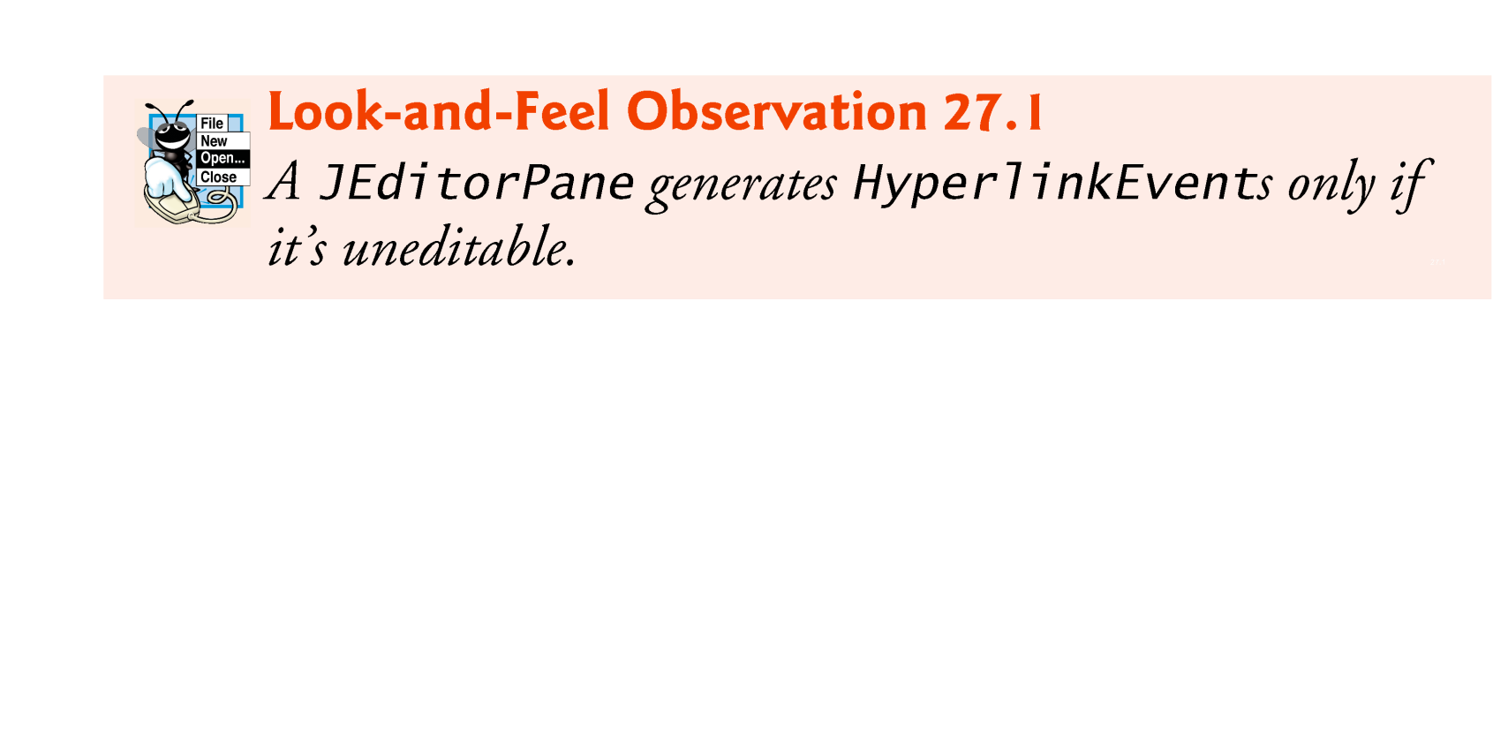

Slide 23
26.4 Establishing a Simple Server Using Stream Sockets
Establishing a simple server in Java requires five steps.
Step 1 is to create a ServerSocket object.
ServerSocket constructor
ServerSocket server = new ServerSocket( portNumber, queueLength );
The constructor establishes the port number where the server waits for connections from clients—a process known as binding the server to the port.
Each client will ask to connect to the server on this port.

Slide 24
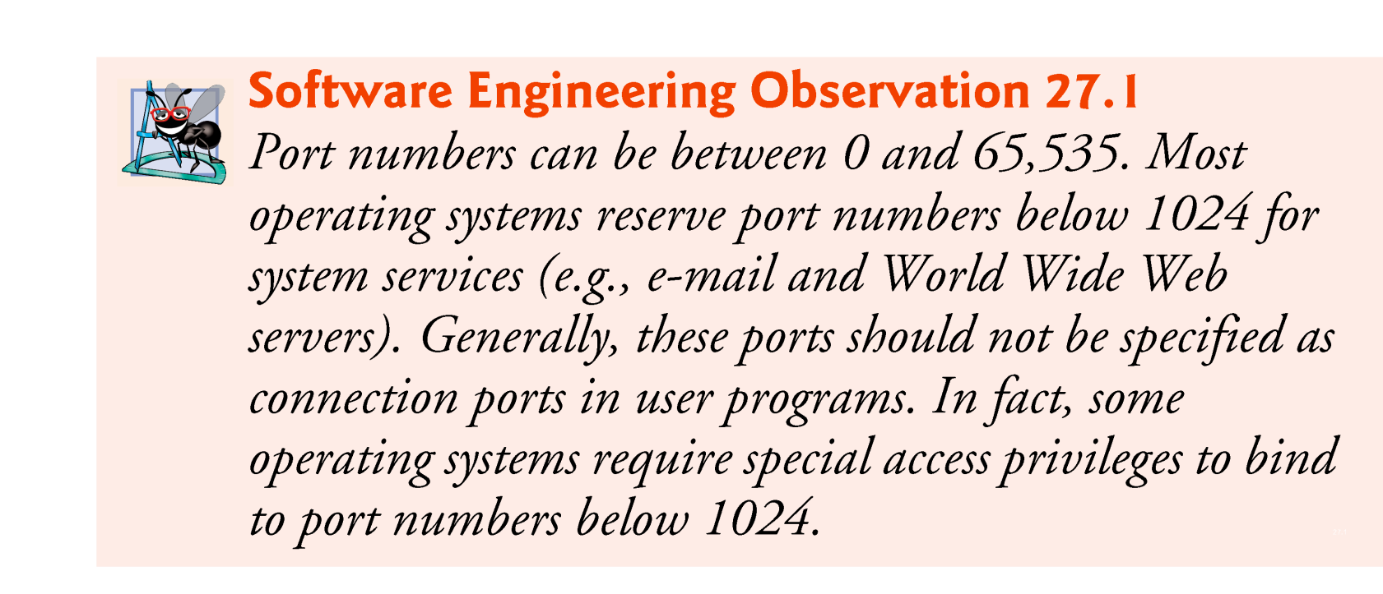

Slide 25
26.4 Establishing a Simple Server Using Stream Sockets (cont.)
Programs manage each client connection with a Socket object.
In Step 2, the server listens indefinitely (or blocks) for an attempt by a client to connect.
To listen for a client connection, the program calls ServerSocket method accept, as in
Socket connection = server.accept();
returns a Socket when a connection with a client is established.
The Socket allows the server to interact with the client.

Slide 26
26.4 Establishing a Simple Server Using Stream Sockets (cont.)
Step 3 is to get the OutputStream and InputStream objects that enable the server to communicate with the client by sending and receiving bytes.
The server invokes method getOutputStream on the Socket to get a reference to the Socket’s OutputStream and invokes method getInputStream on the Socket to get a reference to the Socket’s InputStream.

Slide 27
26.4 Establishing a Simple Server Using Stream Sockets (cont.)
Step 4 is the processing phase, in which the server and the client communicate via the OutputStream and InputStream objects.
In Step 5, when the transmission is complete, the server closes the connection by invoking the close method on the streams and on the Socket.

Slide 28
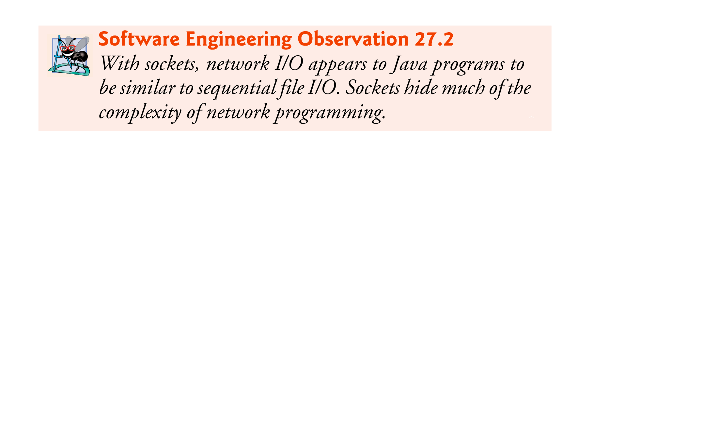

Slide 29
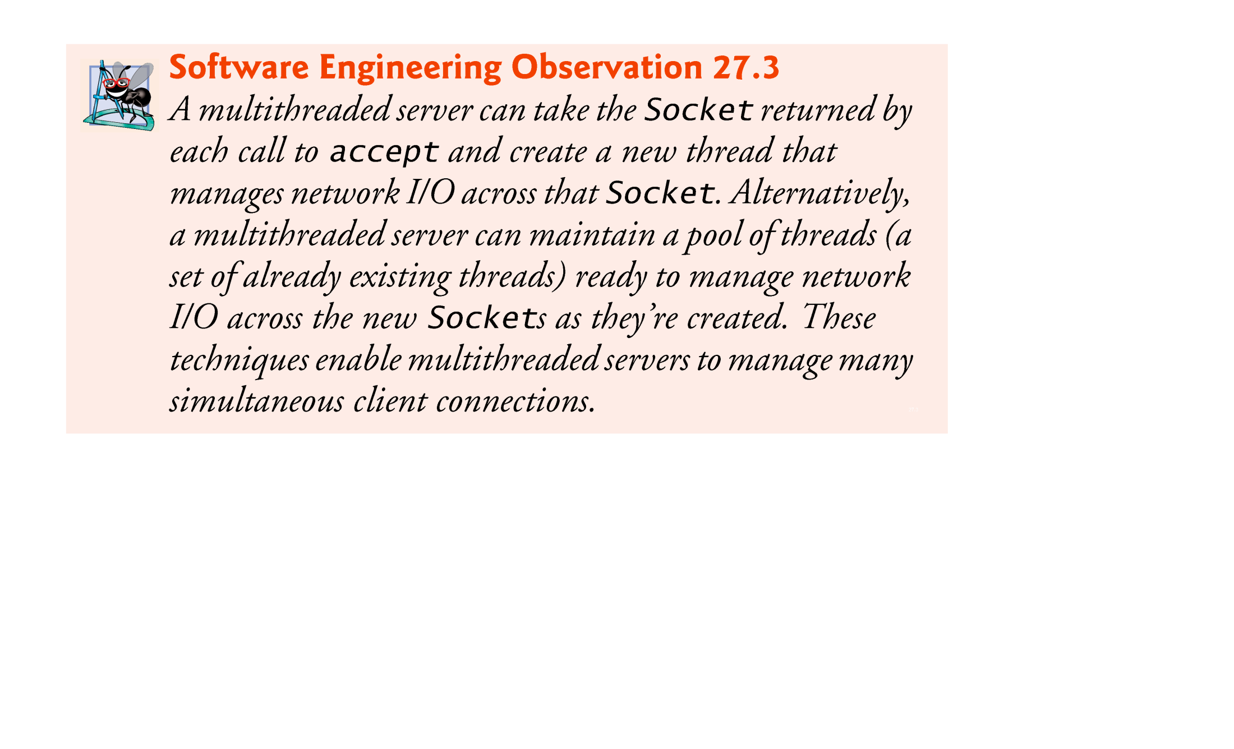

Slide 30
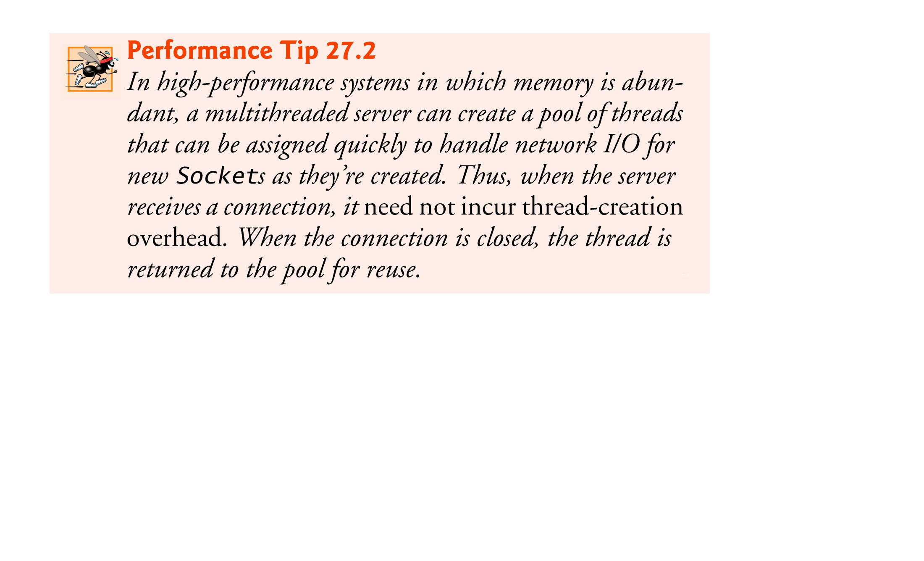

Slide 31
26.5 Establishing a Simple Client Using Stream Sockets
Establishing a simple client in Java requires four steps.
In Step 1, the Socket constructor establishes a connection to the server.
Socket connection = new Socket(serverAddress, port);
If the connection attempt is successful, this statement returns a Socket.
A connection attempt that fails throws an instance of a subclass of IOException.
An UnknownHostException occurs when the system is unable to resolve the server name.

Slide 32
26.5 Establishing a Simple Client Using Stream Sockets (cont.)
In Step 2, the client uses Socket methods getInputStream and getOutputStream to obtain references to the Socket’s InputStream and OutputStream.
Step 3 is the processing phase in which the client and the server communicate via the InputStream and OutputStream objects.
In Step 4, the client closes the connection when the transmission is complete by invoking the close method on the streams and on the Socket.

Slide 33
26.6 Client/Server Interaction with Stream Socket Connections
Figures 26.5 and 26.7 present a simple client-/server chat application.

Slide 34
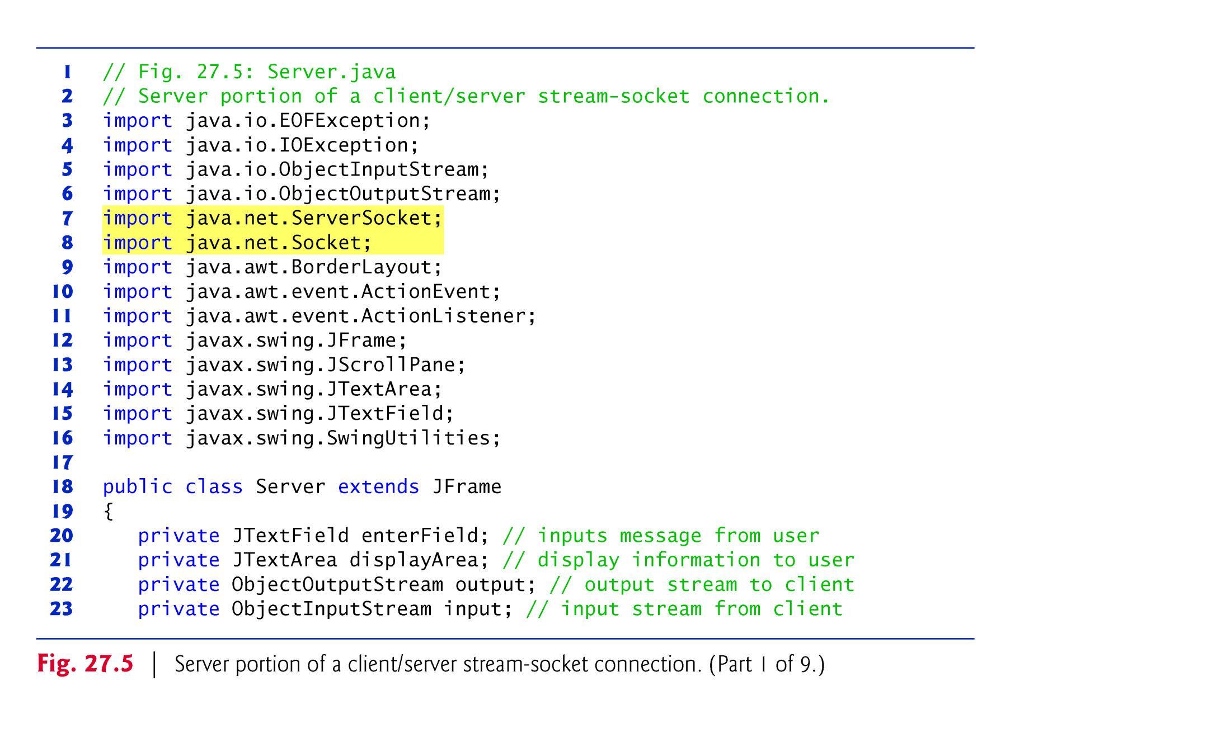

Slide 35
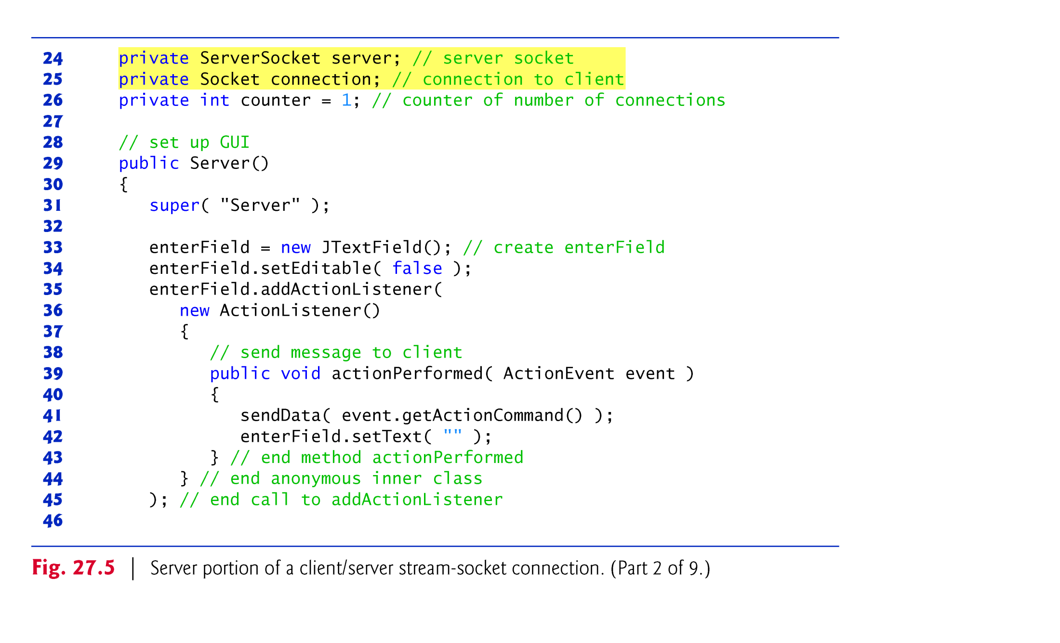

Slide 36
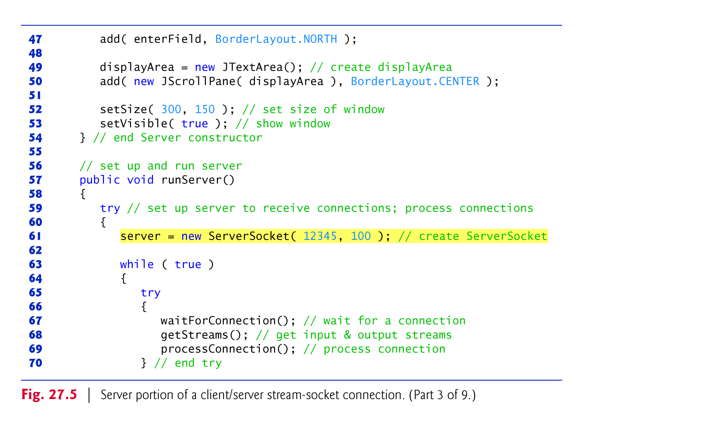

Slide 37
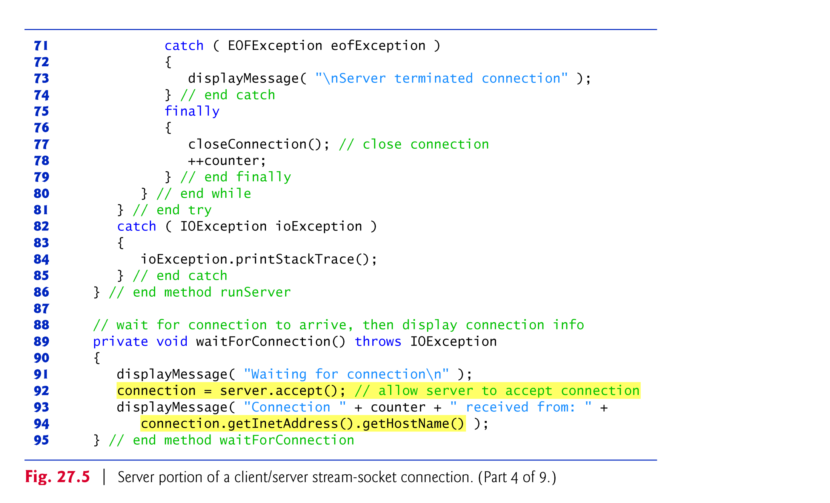

Slide 38
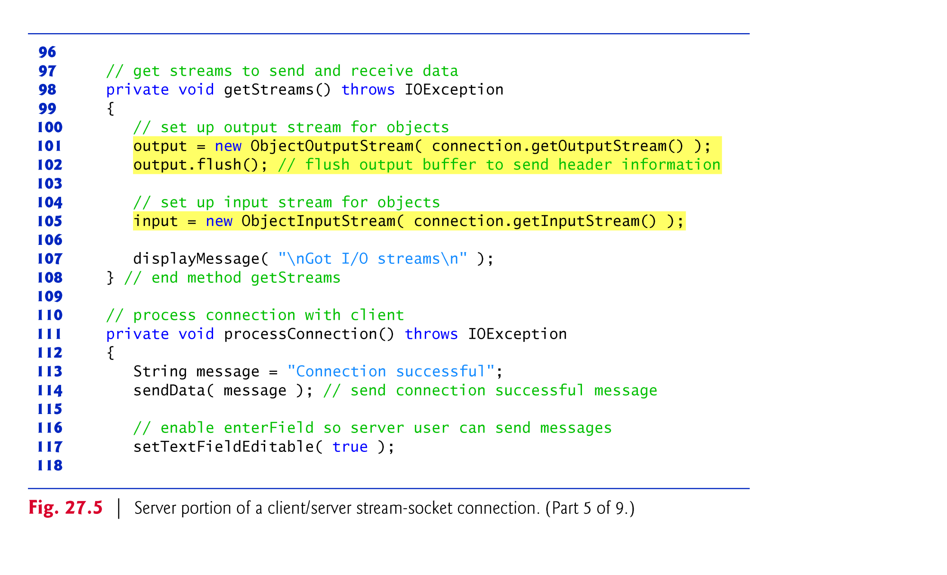

Slide 39
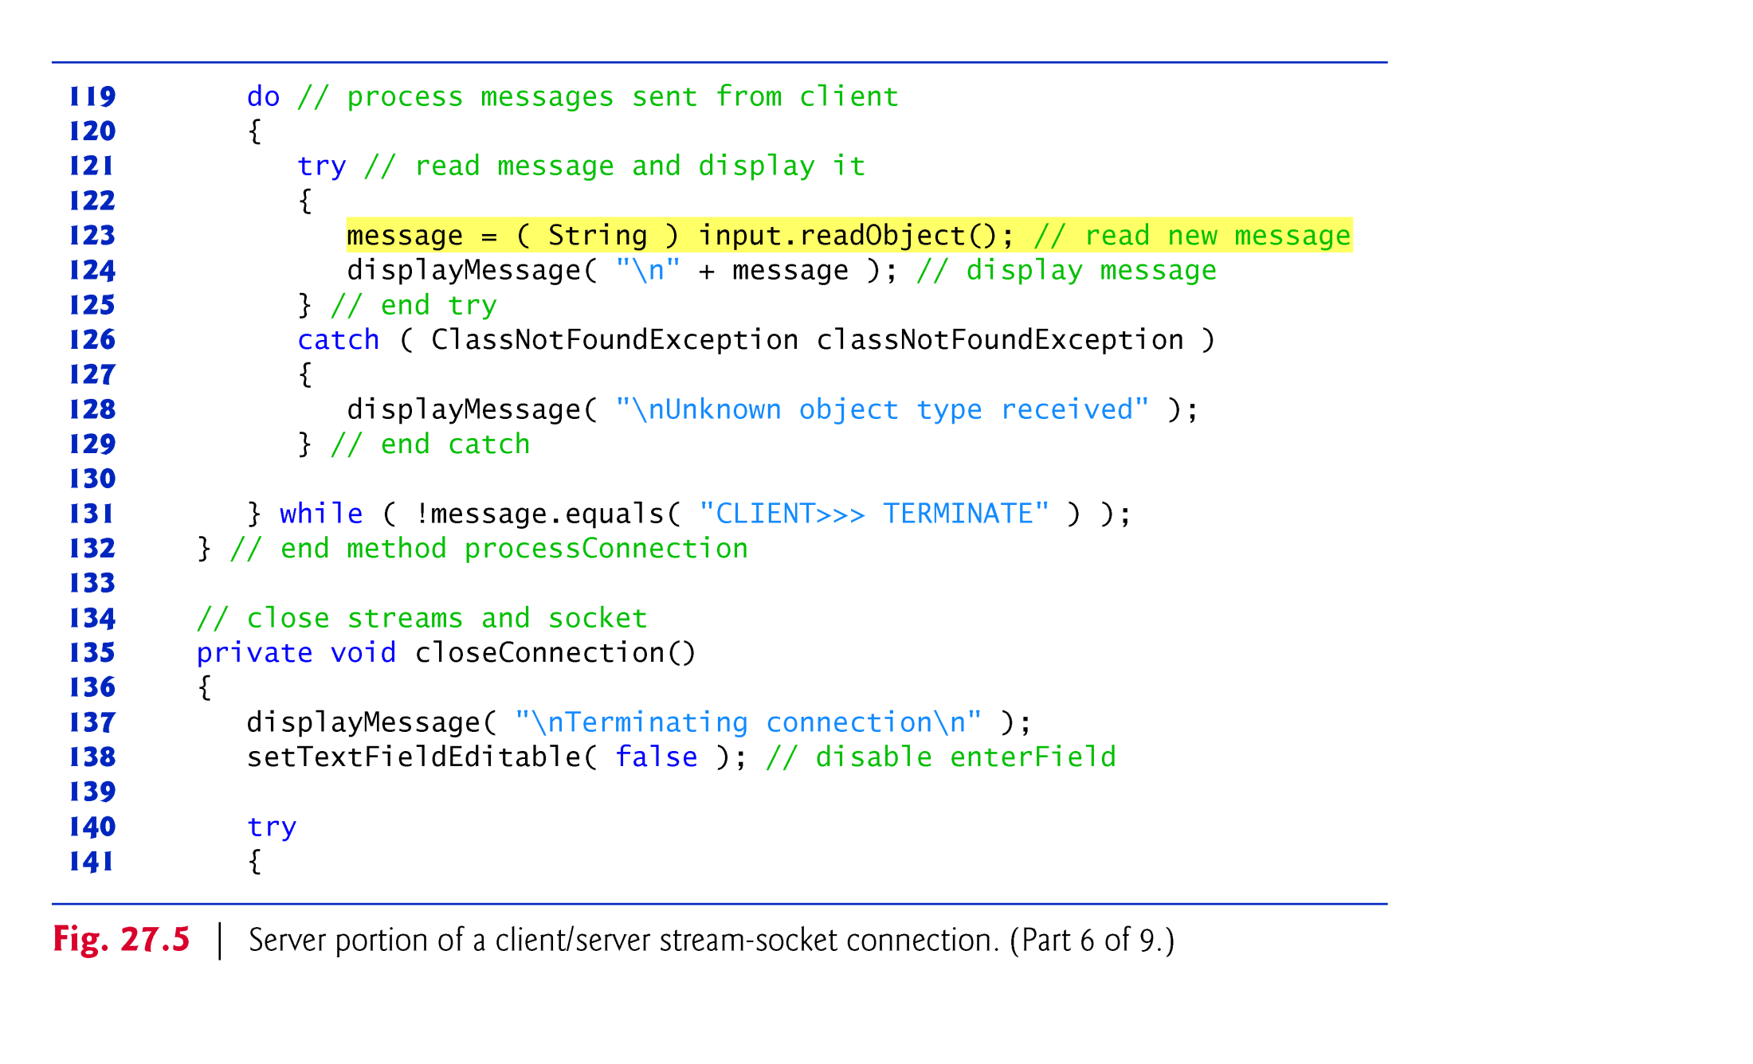

Slide 40
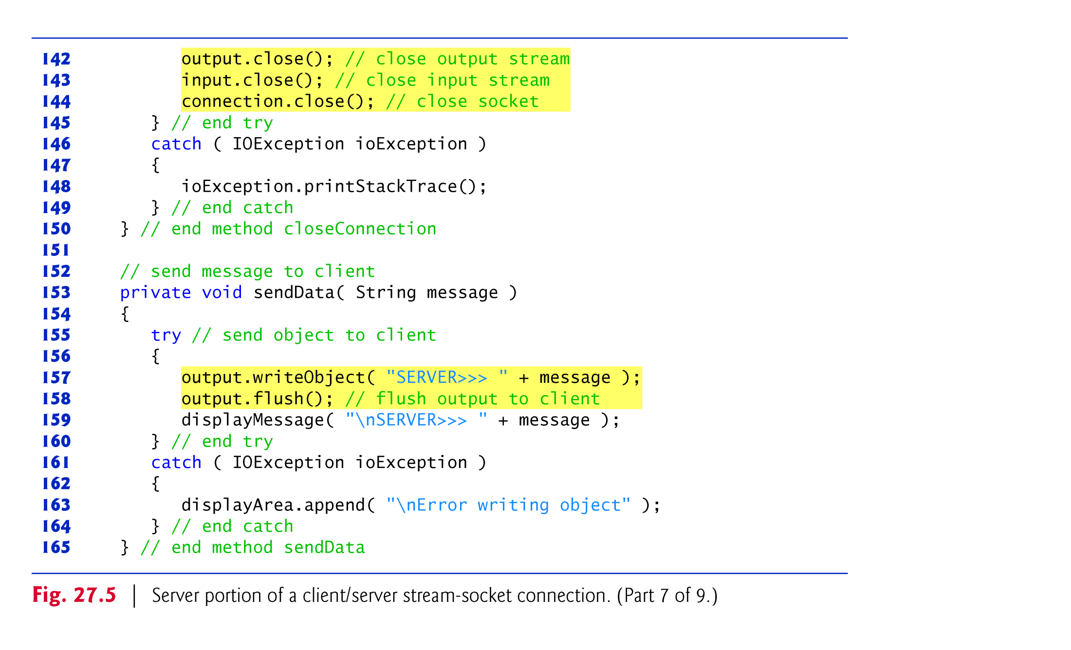

Slide 41
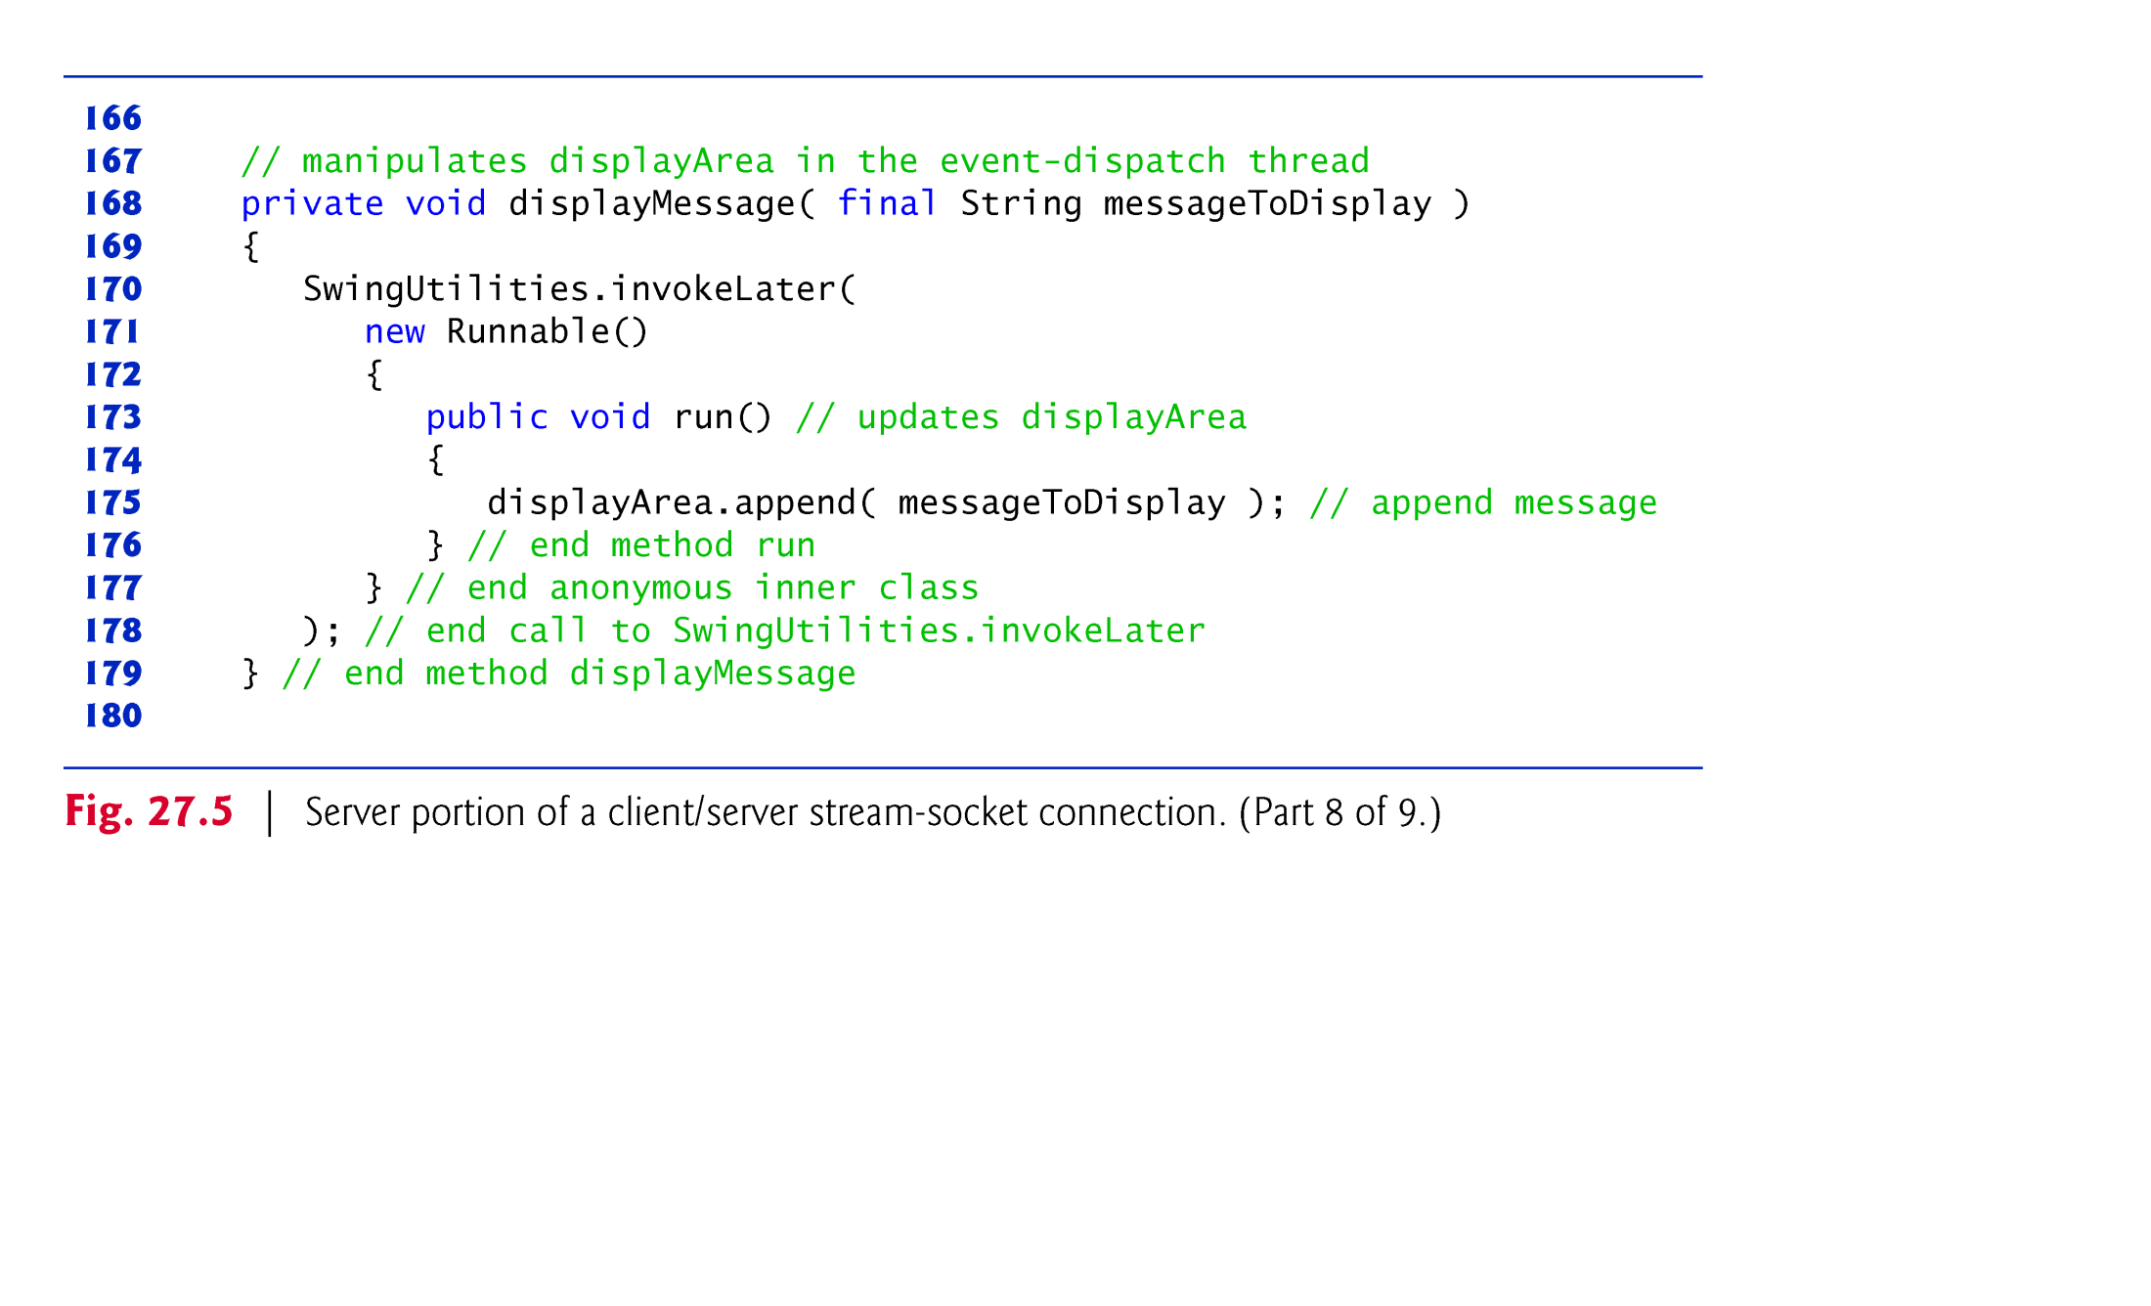

Slide 42
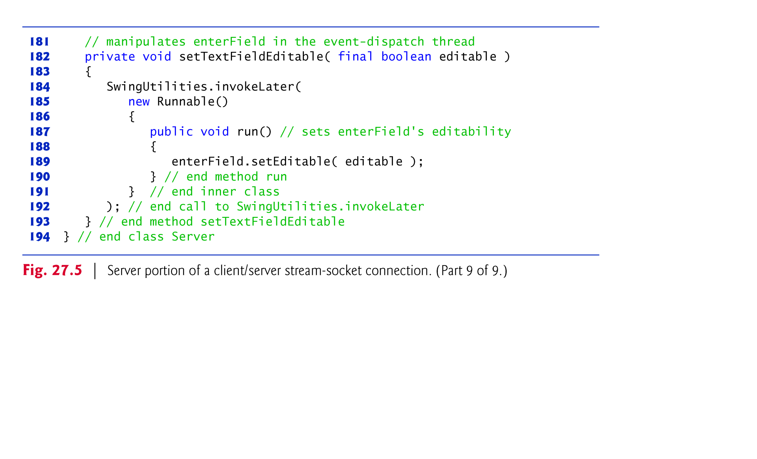

Slide 43
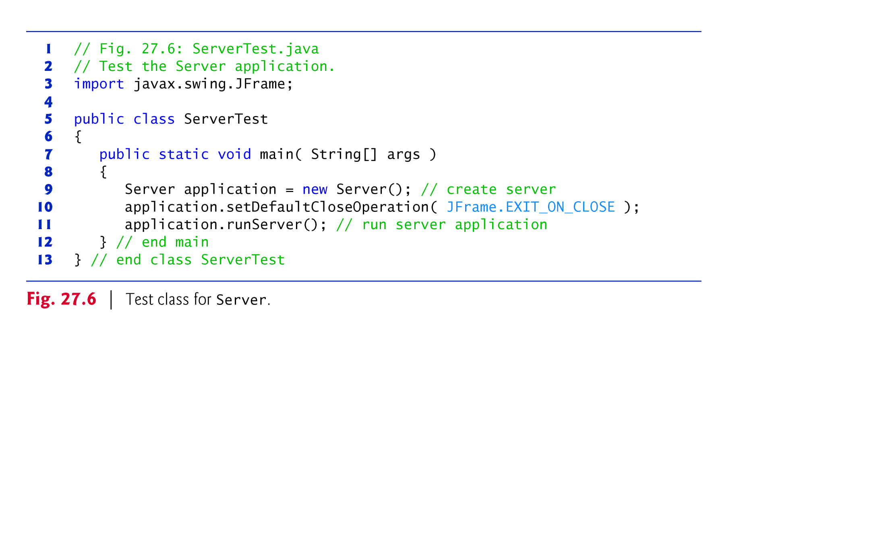

Slide 44
26.6 Client/Server Interaction with Stream Socket Connections (cont.)
SwingUtilities method invokeLater receives a Runnable object as its argument and places it into the event-dispatch thread for execution.
Ensures that we don’t modify a GUI component from a thread other than the event-dispatch thread.

Slide 45
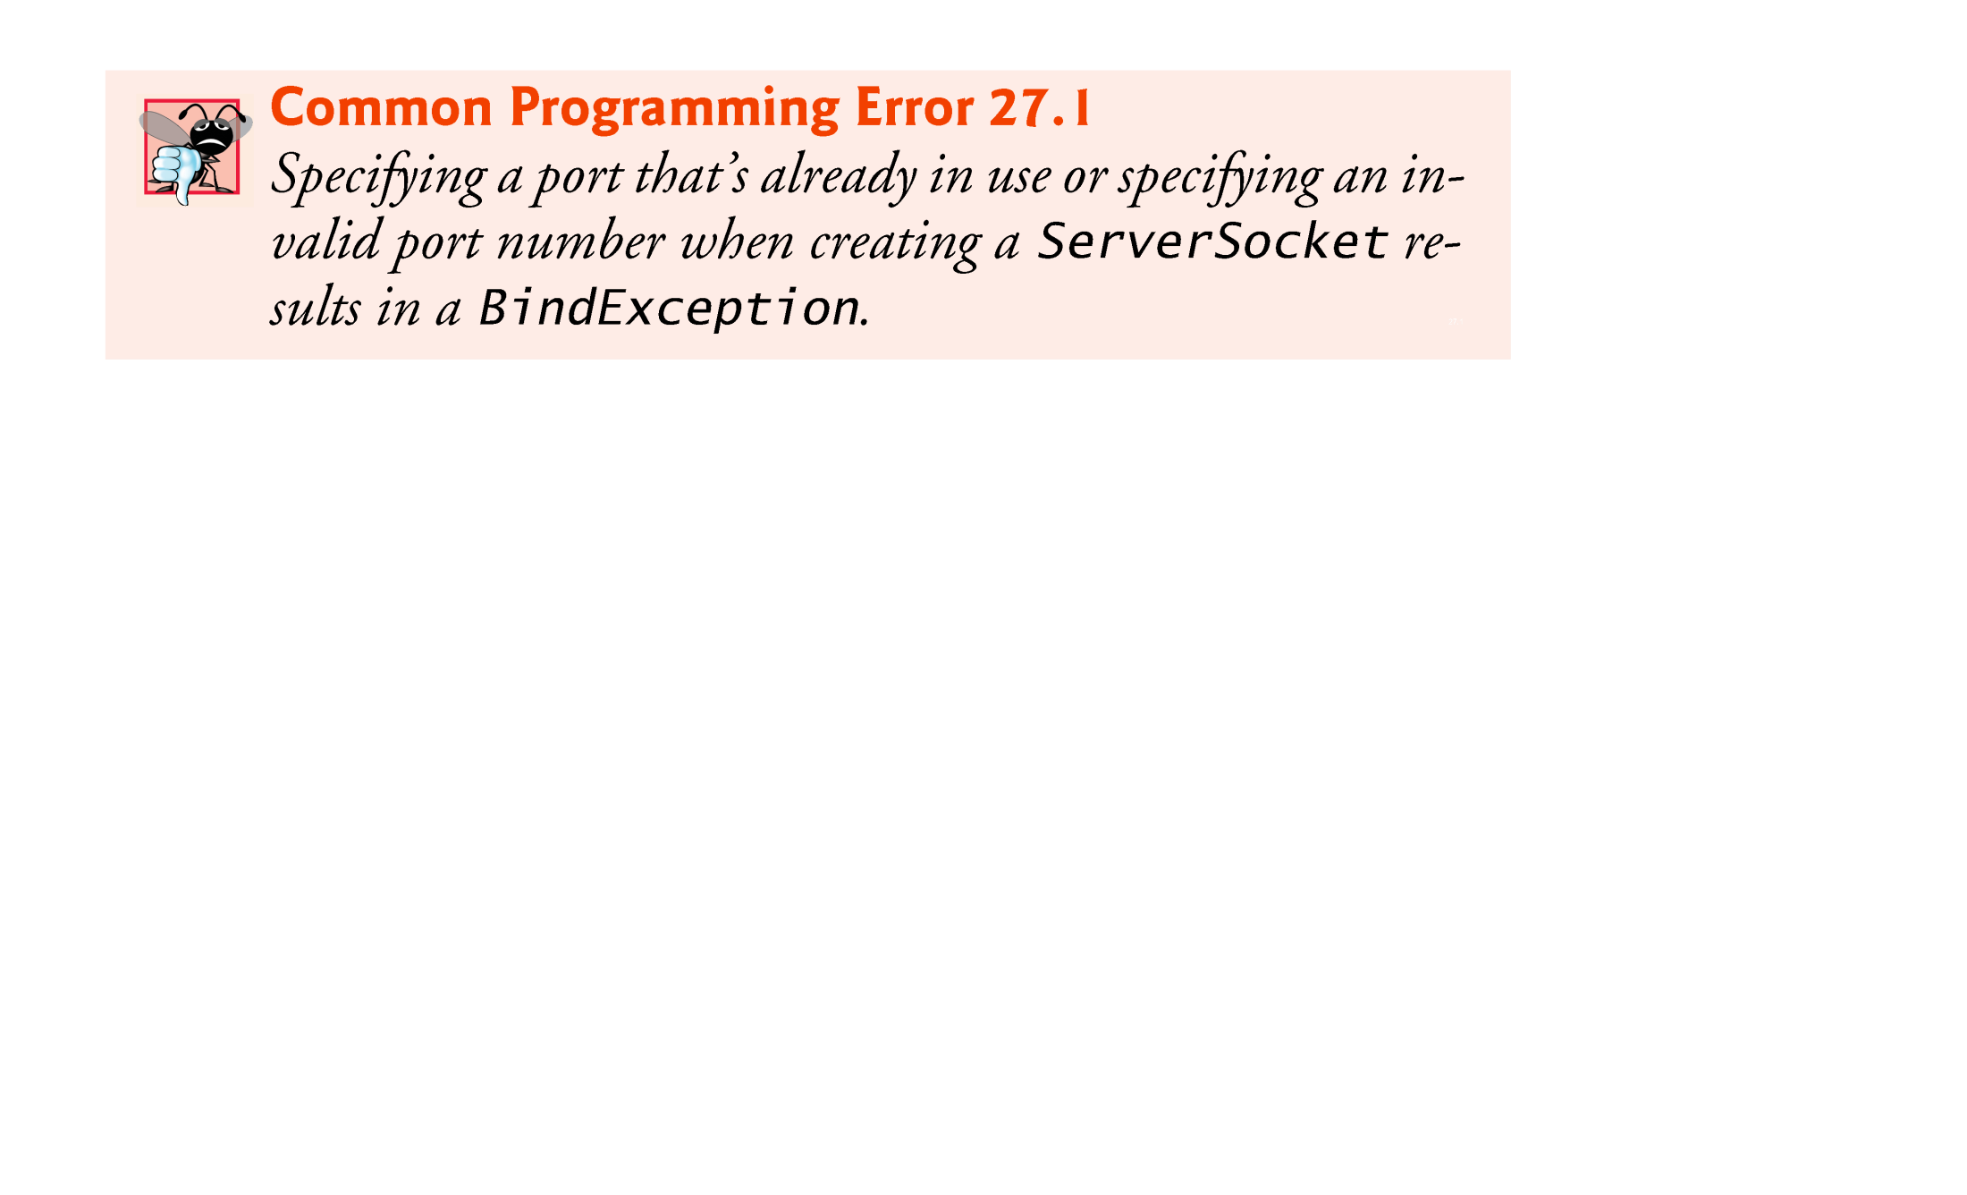

Slide 46
26.6 Client/Server Interaction with Stream Socket Connections (cont.)
Socket method getInet-Address returns an InetAddress (package java.net) containing information about the client computer.
InetAddress method getHostName returns the host name of the client computer.
IP address (127.0.0.1) and host name (localhost) are useful for testing networking applications on your local computer
known as the loopback address

Slide 47
26.6 Client/Server Interaction with Stream Socket Connections (cont.)
Note the call to ObjectOutputStream method flush.
Causes the ObjectOutputStream on the server to send a stream header to the corresponding client’s ObjectInputStream.
The stream header contains such information as the version of object serialization being used to send objects.
This information is required by the ObjectInputStream so that it can prepare to receive those objects correctly.
Notes:
netAddress是Java对IP地址的封装

Slide 48
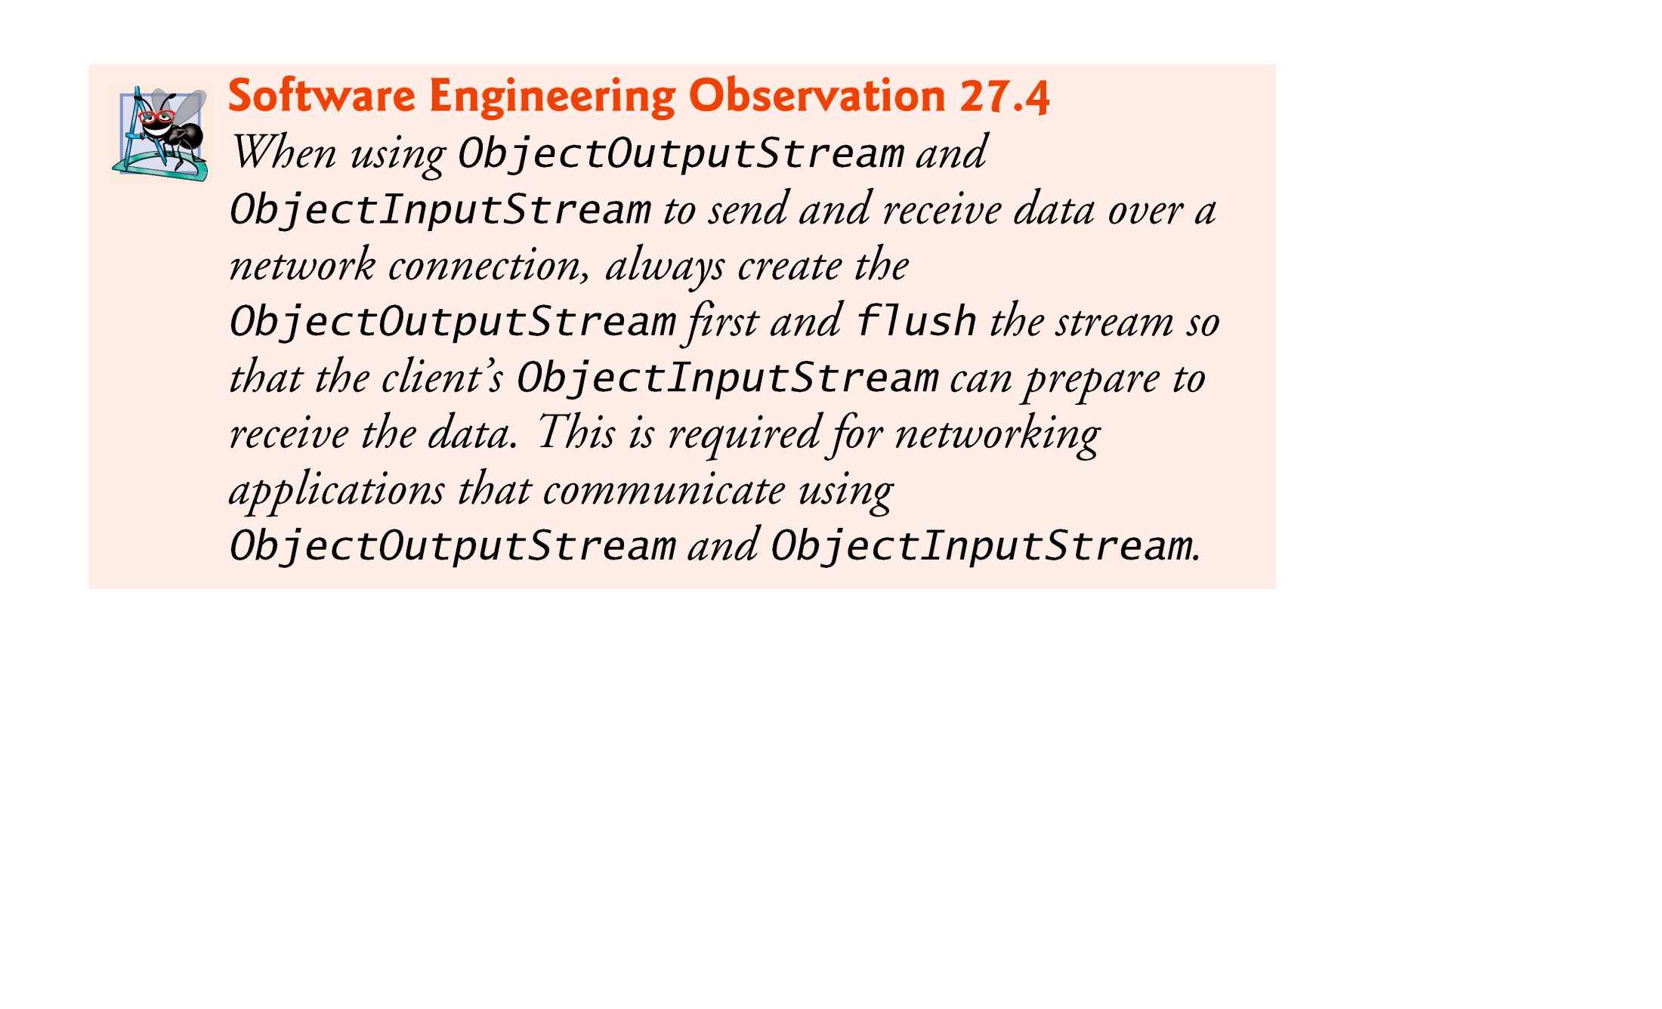

Slide 49
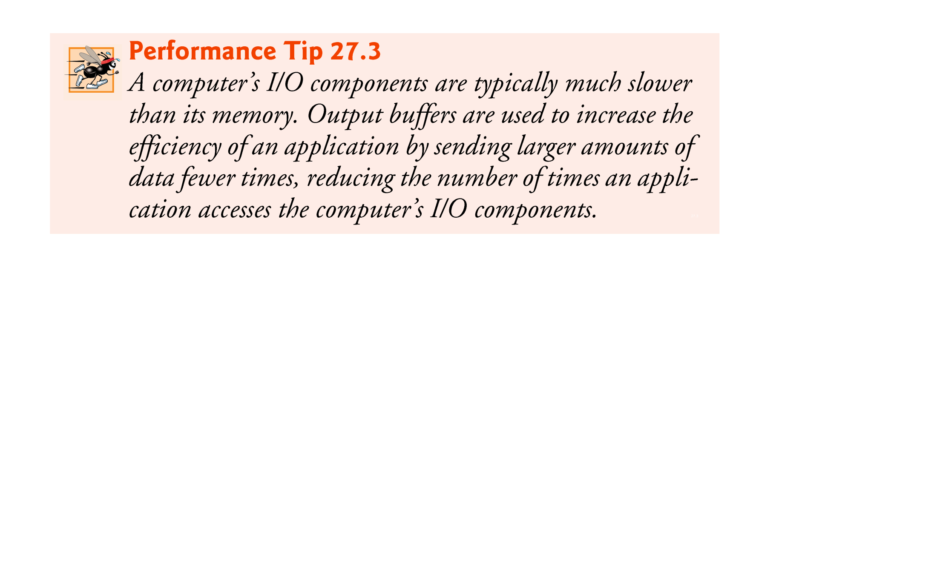

Slide 50
26.6 Client/Server Interaction with Stream Socket Connections (cont.)
In this example, you can execute the client from any computer on the Internet and specify the IP address or host name of the server computer as a command-line argument to the program.
The following command attempts to connect to the Server on the computer with IP address 192.168.1.15
java Client 192.168.1.15

Slide 51
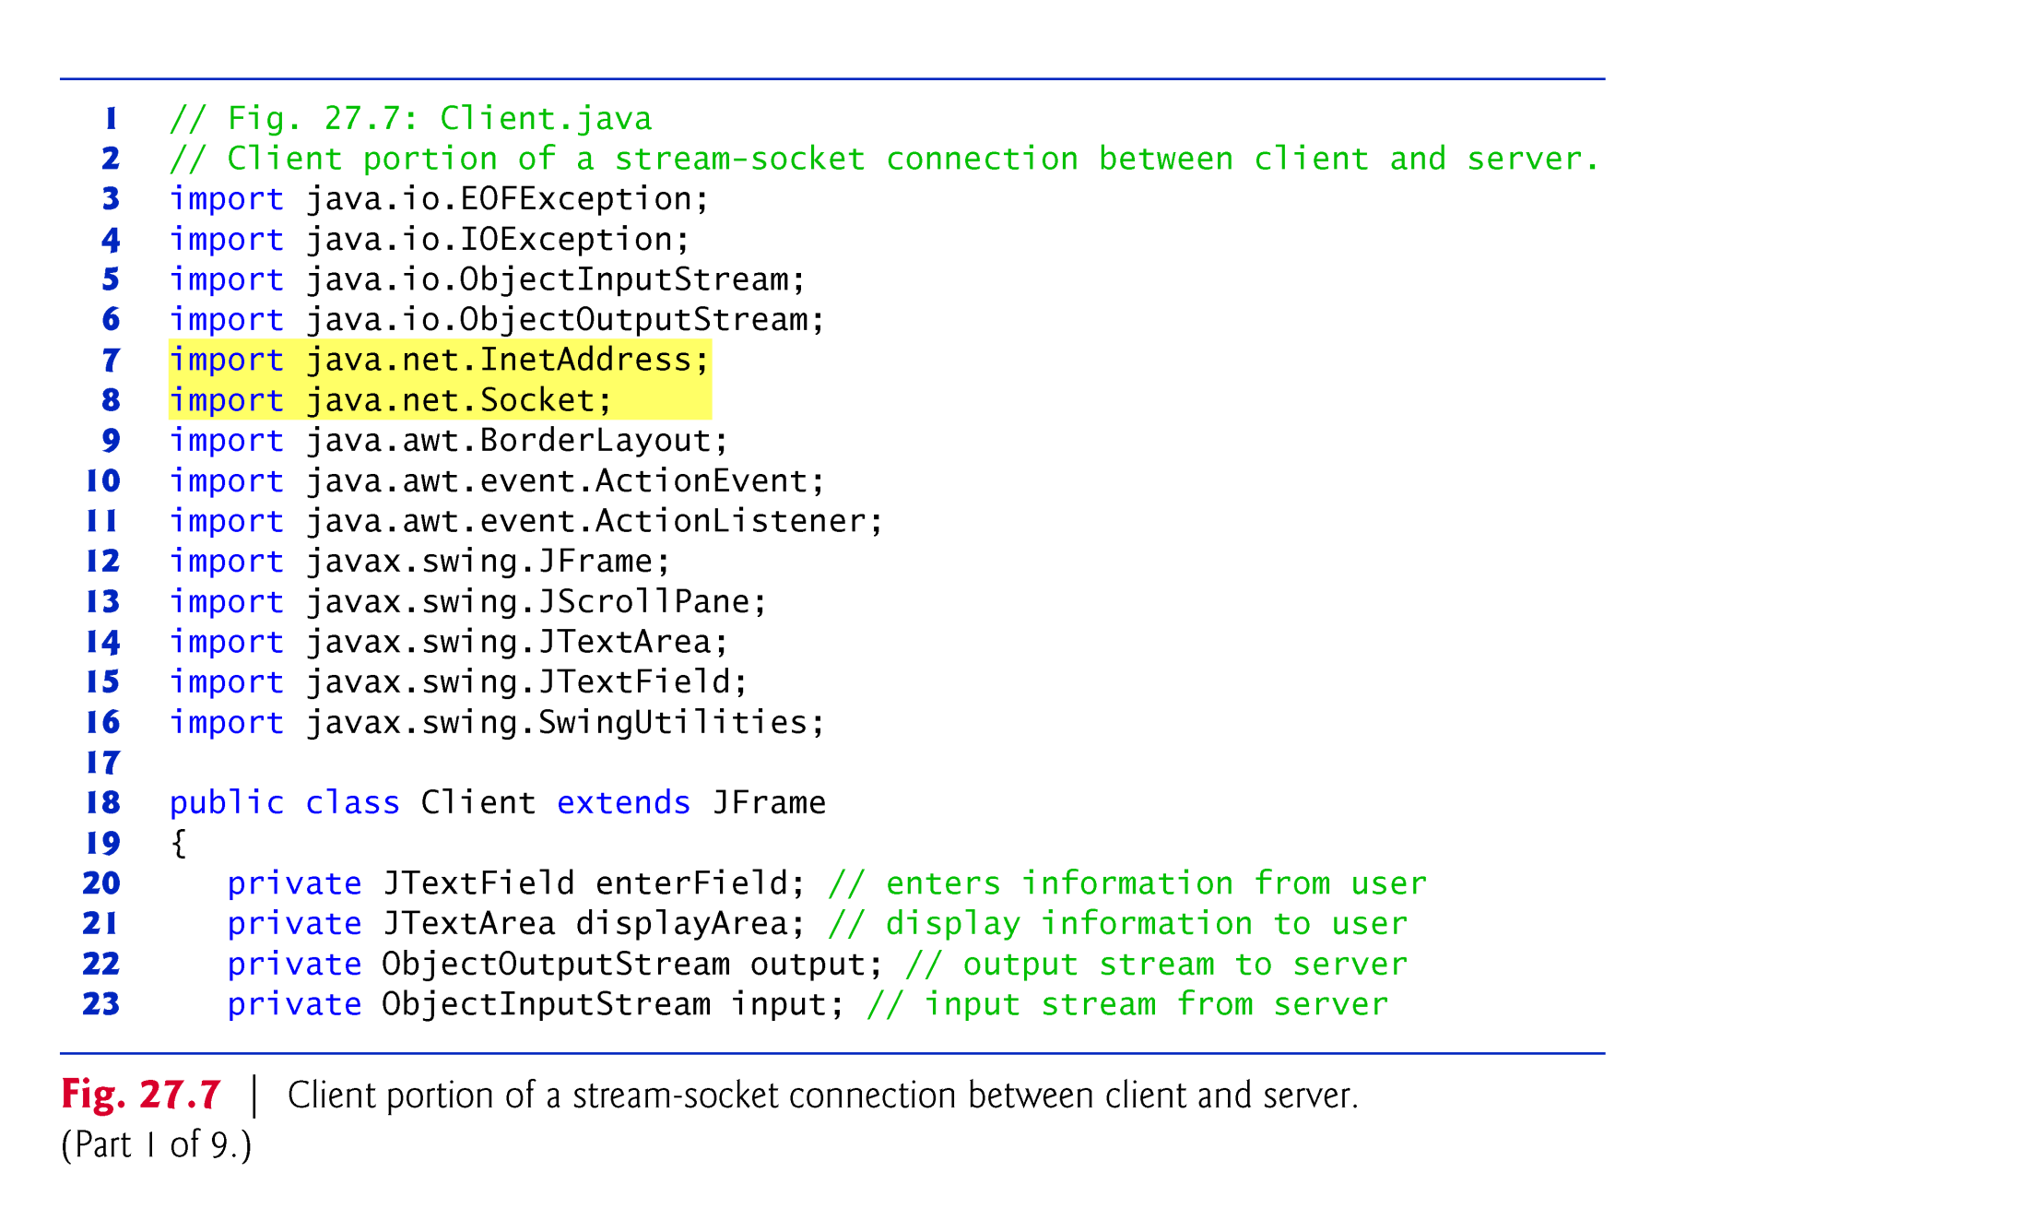

Slide 52
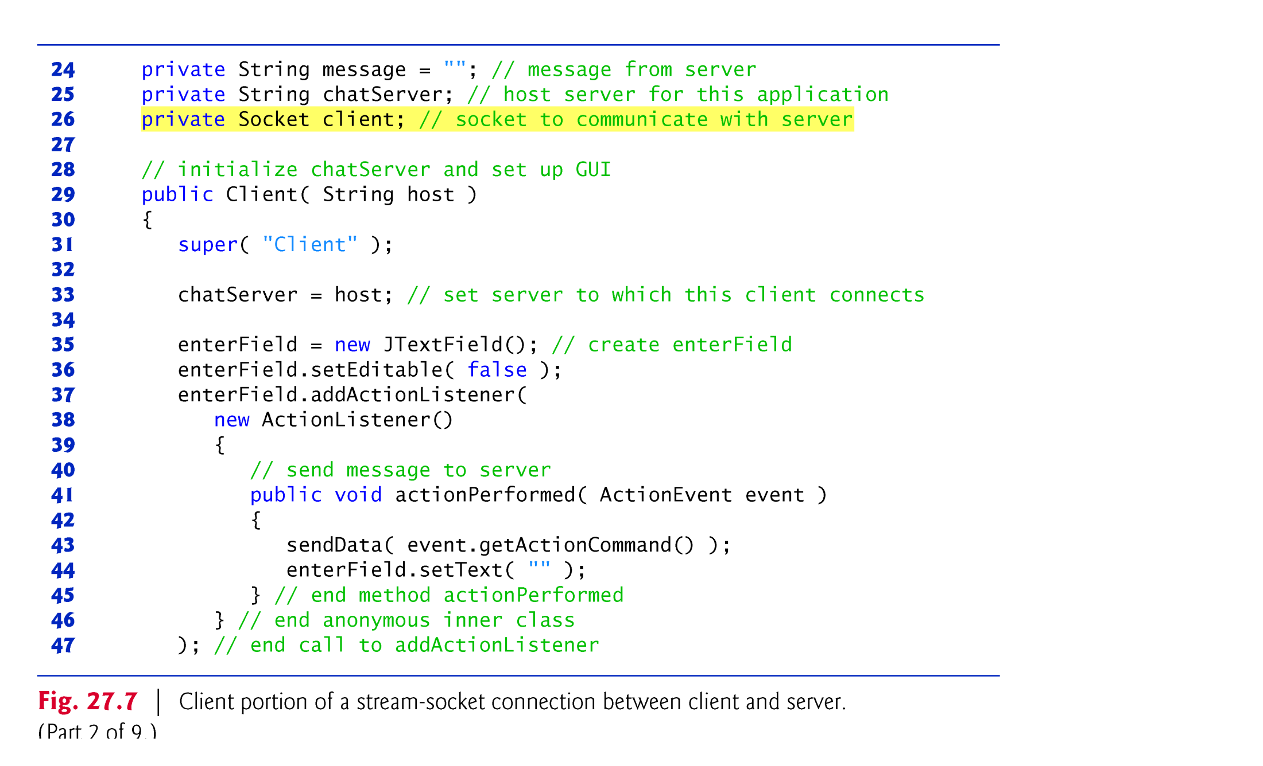

Slide 53
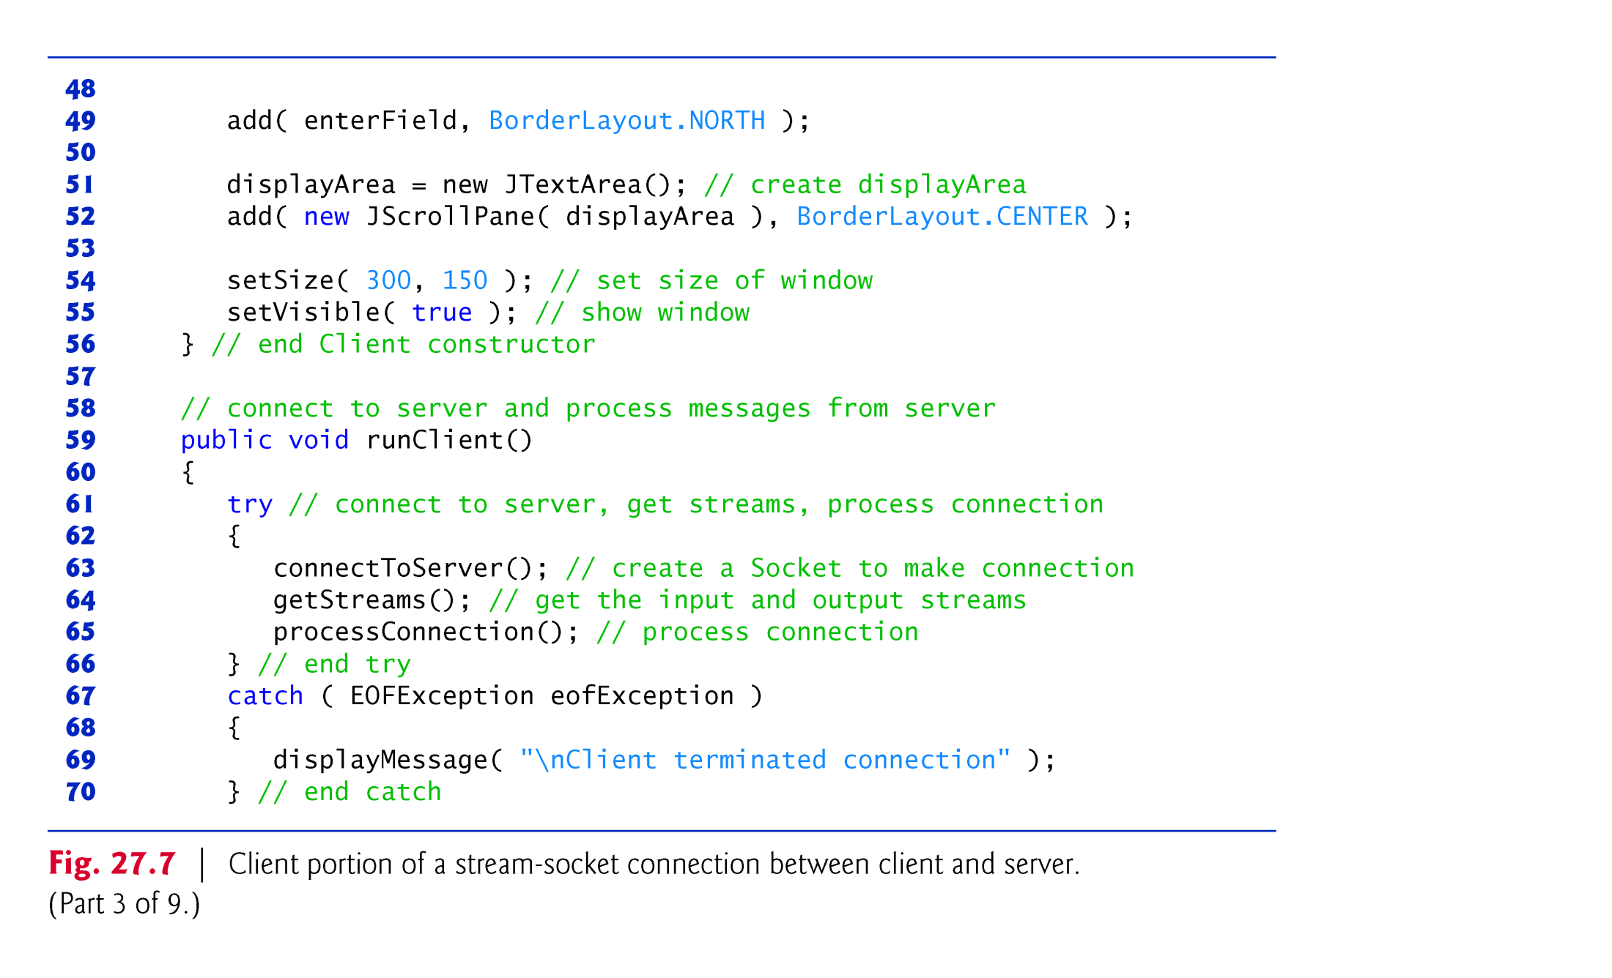

Slide 54
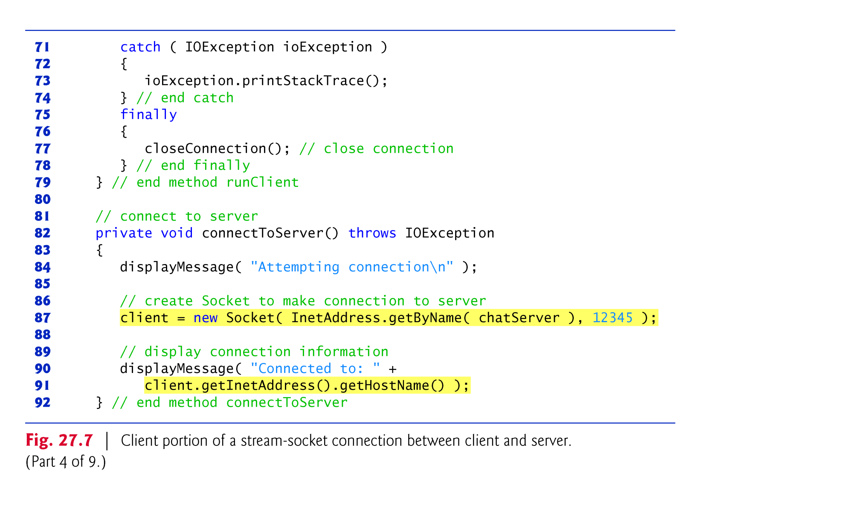

Slide 55
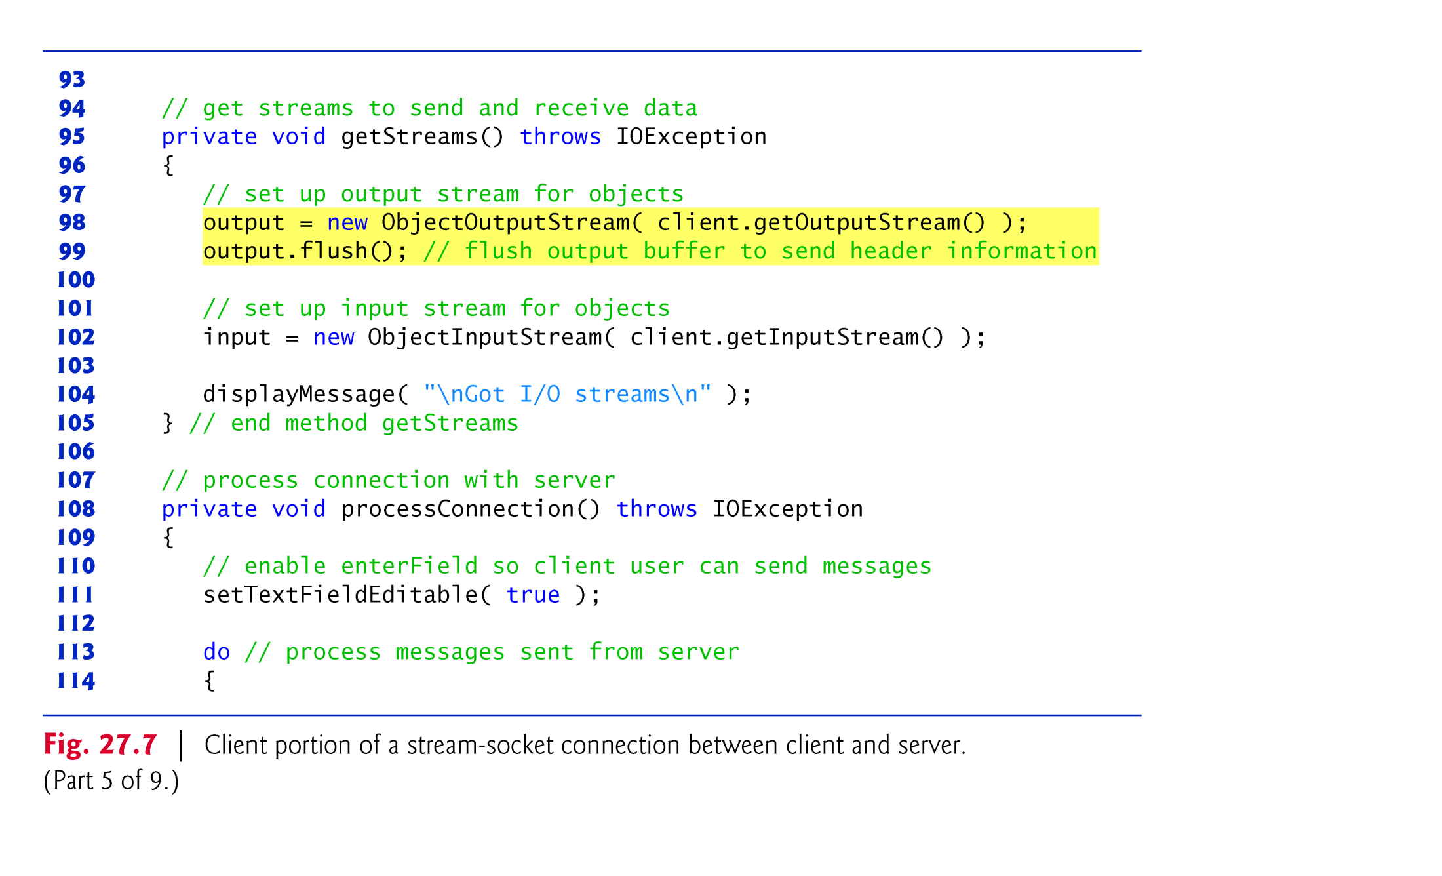

Slide 56
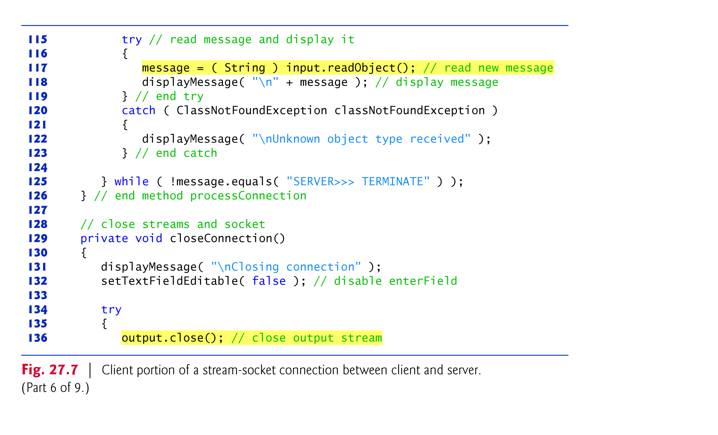

Slide 57
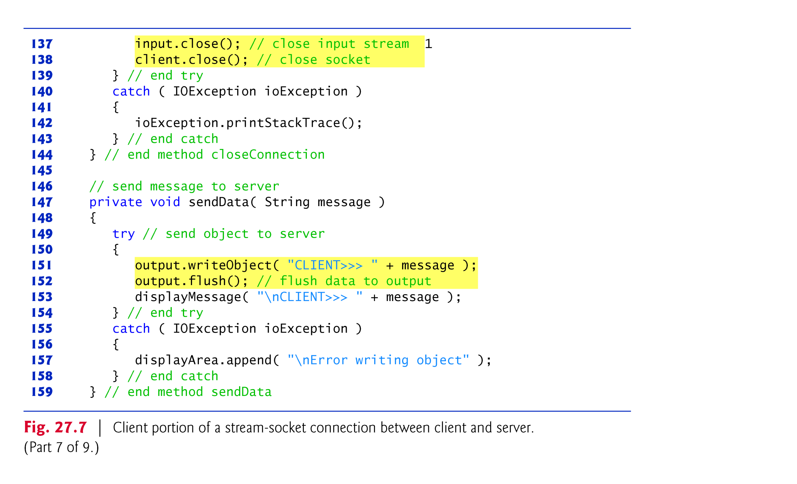

Slide 58
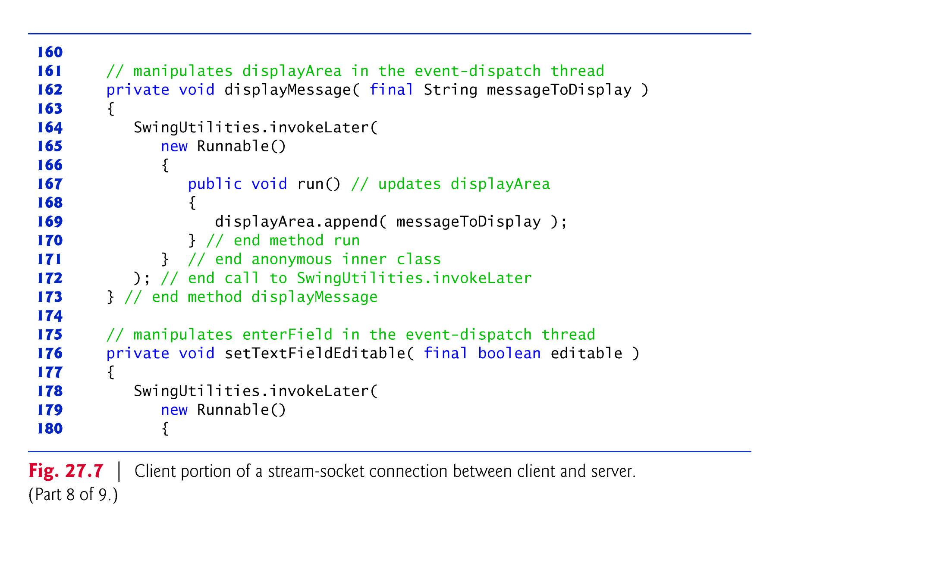

Slide 59
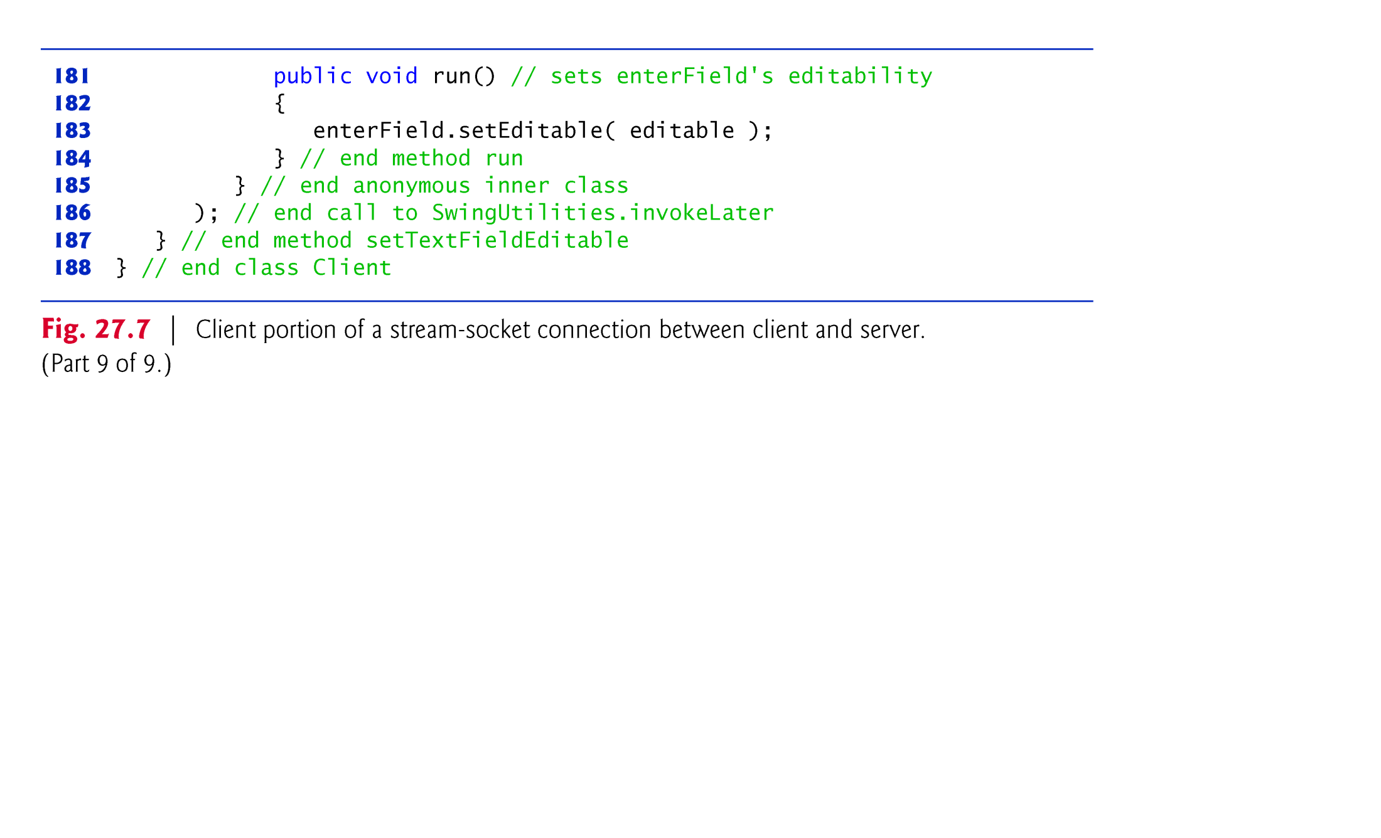

Slide 60
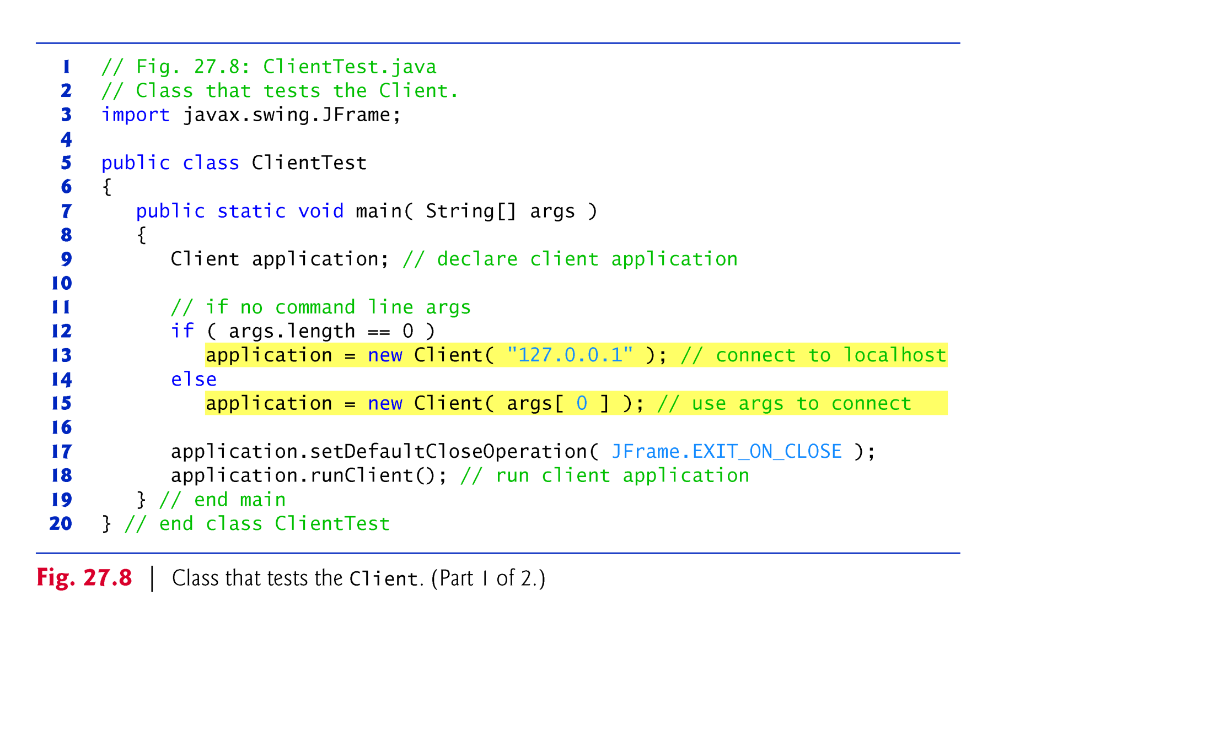

Slide 61
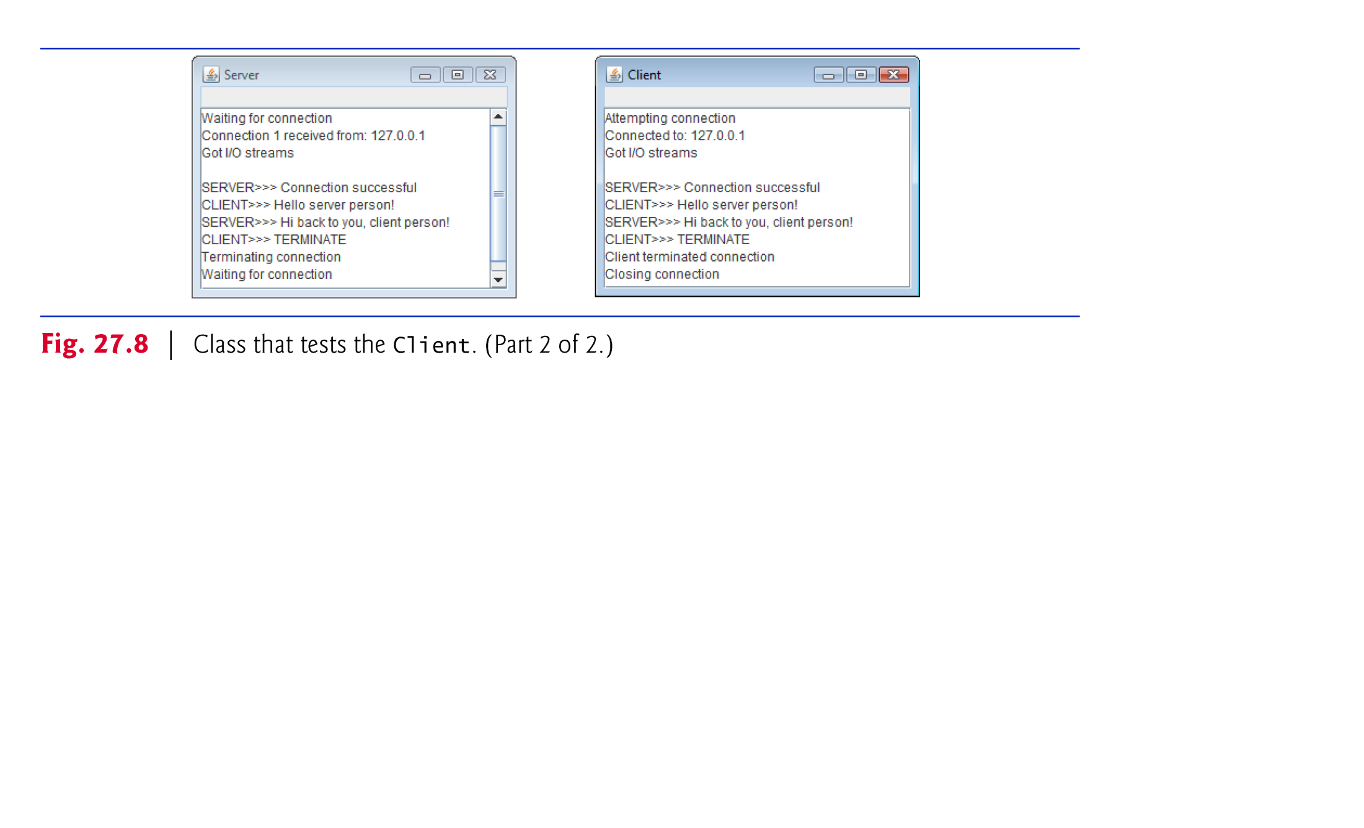

Slide 62
26.6 Client/Server Interaction with Stream Socket Connections (cont.)
InetAddress static method getByName returns an InetAddress object containing the specified IP address
Method getByName can receive a String containing either the actual IP address or the host name of the server.
The first argument also could have been written other ways.
For the localhost address 127.0.0.1, the first argument could be specified with either of the following expressions:
InetAddress.getByName( "localhost" ) InetAddress.getLocalHost()

Slide 63
26.7 Connectionless Client/Server Interaction with Datagrams
Connectionless transmission with datagrams.
Connection-oriented transmission is like the telephone system
You dial and are given a connection to the telephone of the person with whom you wish to communicate.
The connection is maintained for your phone call, even when you’re not talking.
Connectionless transmission with datagrams is more like the way mail is carried via the postal service.
If a large message will not fit in one envelope, you break it into separate pieces that you place in sequentially numbered envelopes.
All of the letters are then mailed at once.
The letters could arrive in order, out of order or not at all (the last case is rare).

Slide 64
26.7 Connectionless Client/Server Interaction with Datagrams (cont.)
Class Server declares two DatagramPackets that the server uses to send and receive information and one DatagramSocket that sends and receives the packets.
The DatagramSocket constructor that takes an integer port-number argument binds the server to a port where it can receive packets from clients.
Clients sending packets to this Server specify the same port number in the packets they send.
A Socket-Exception is thrown if the DatagramSocket constructor fails to bind the DatagramSocket to the specified port.

Slide 65


Slide 66
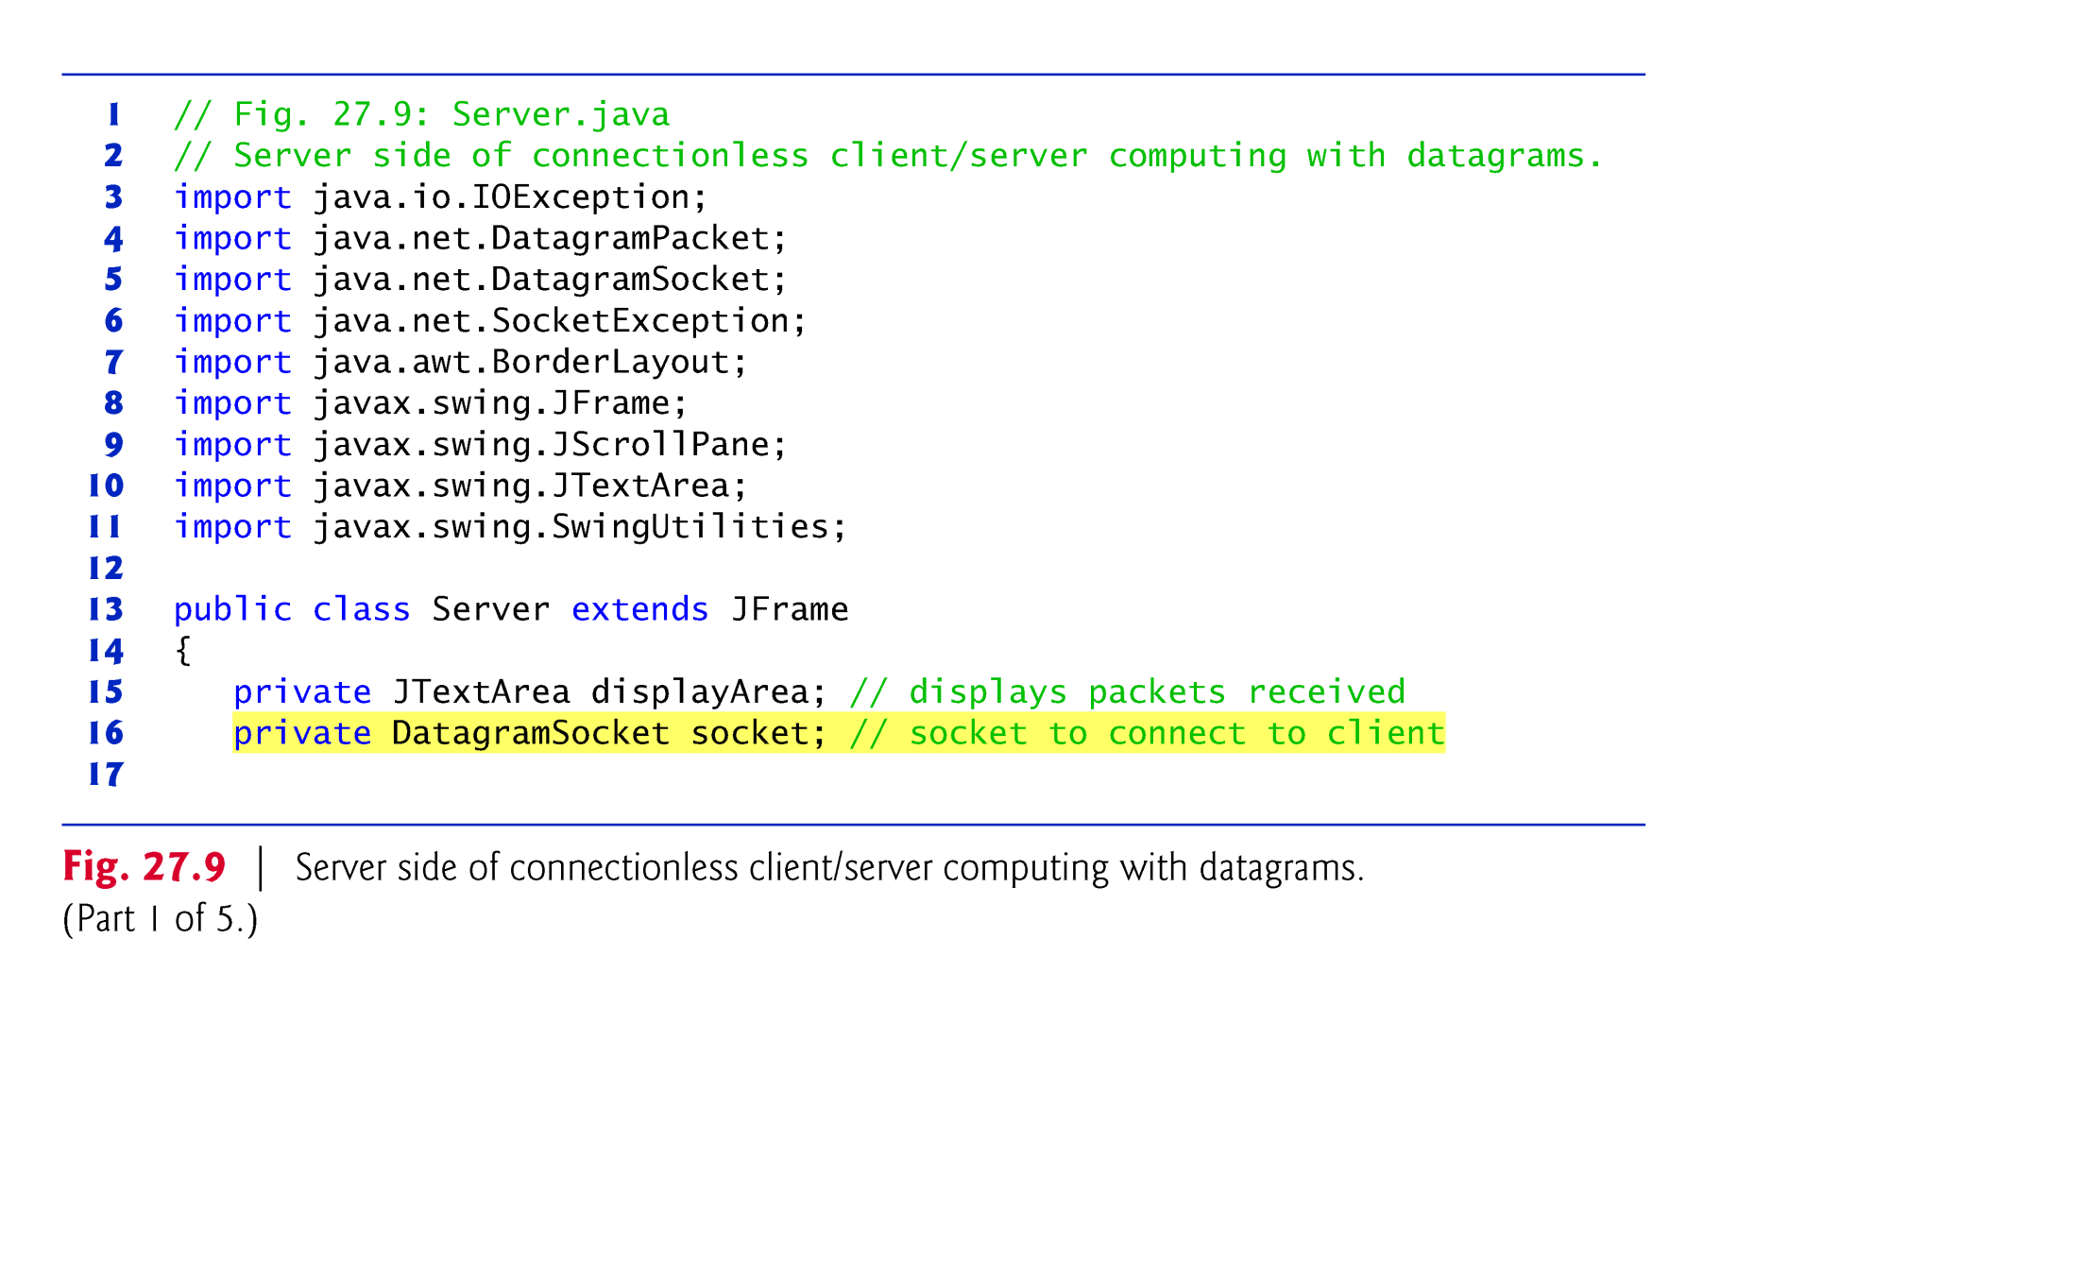

Slide 67
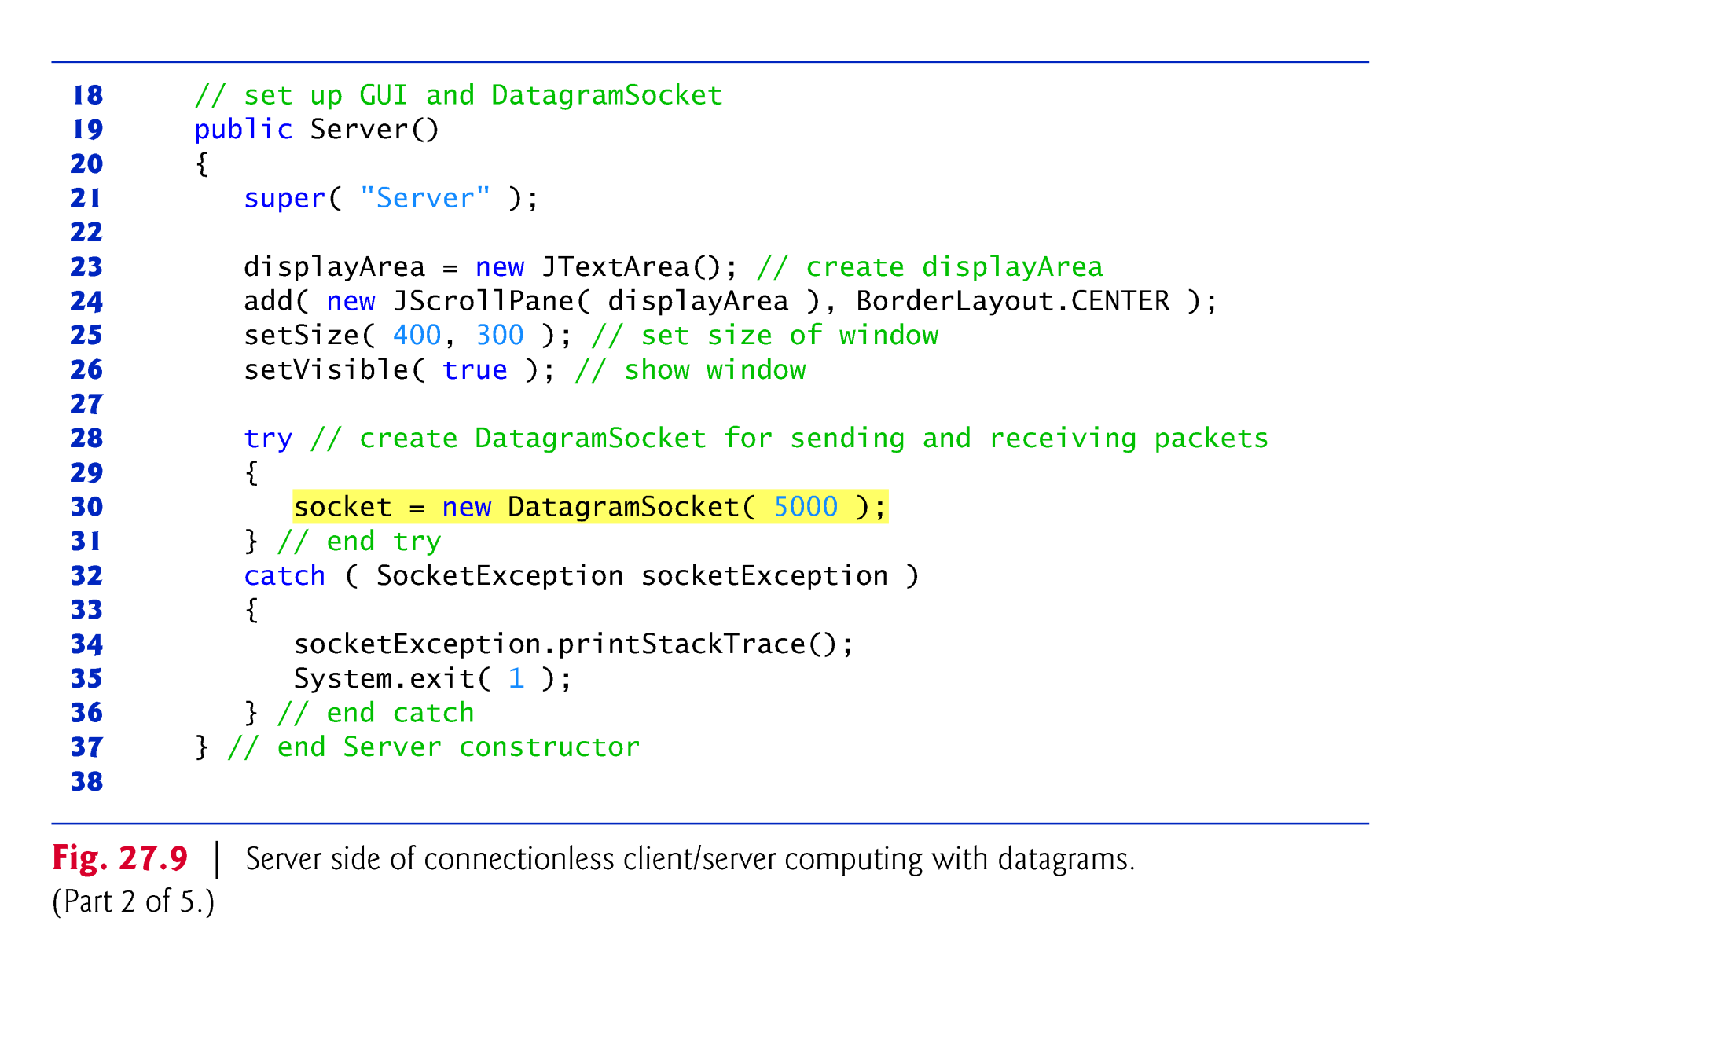

Slide 68
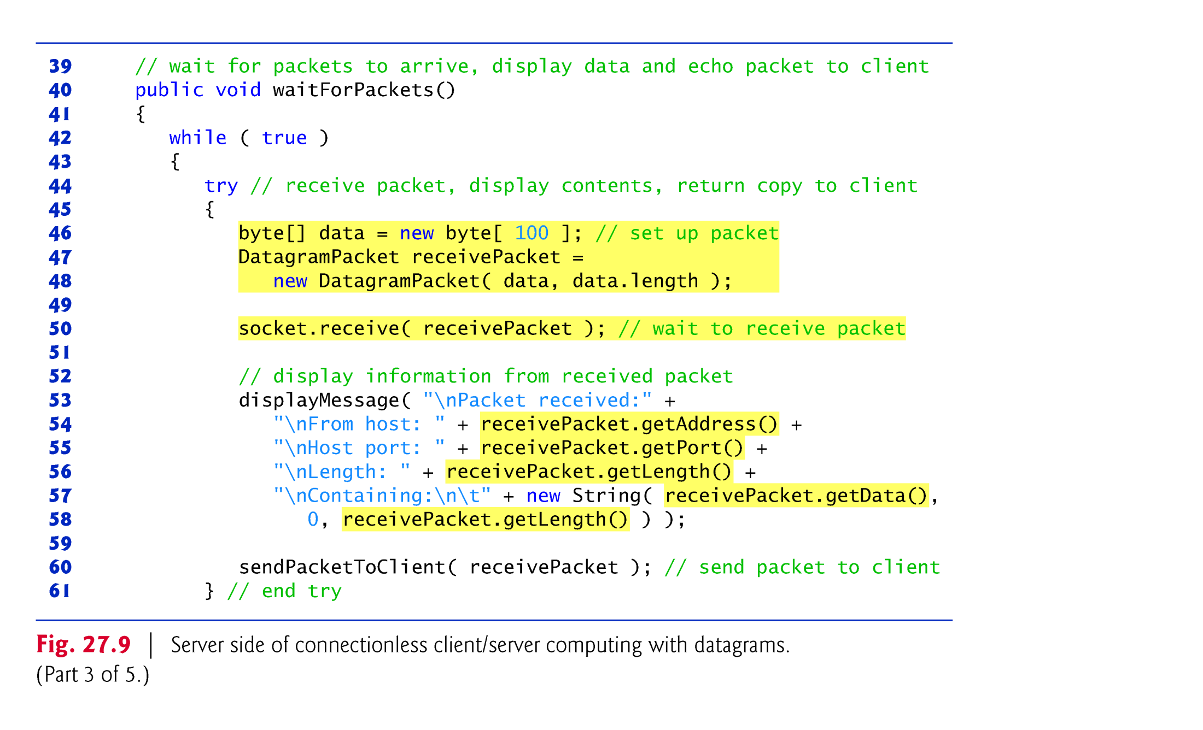

Slide 69
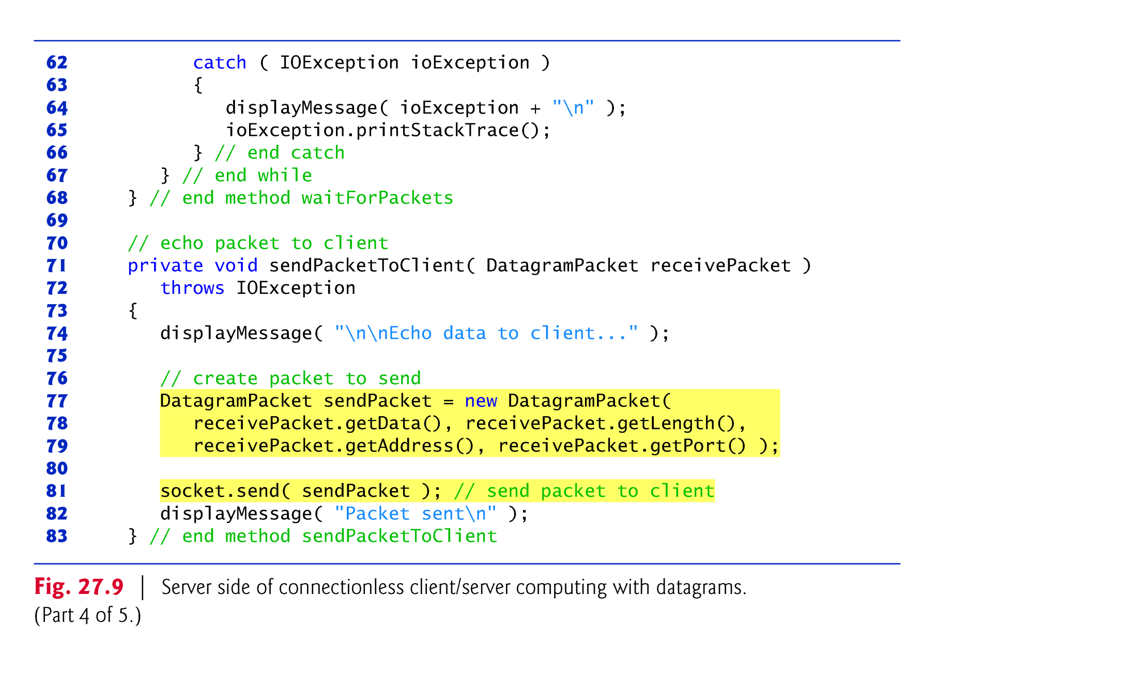

Slide 70
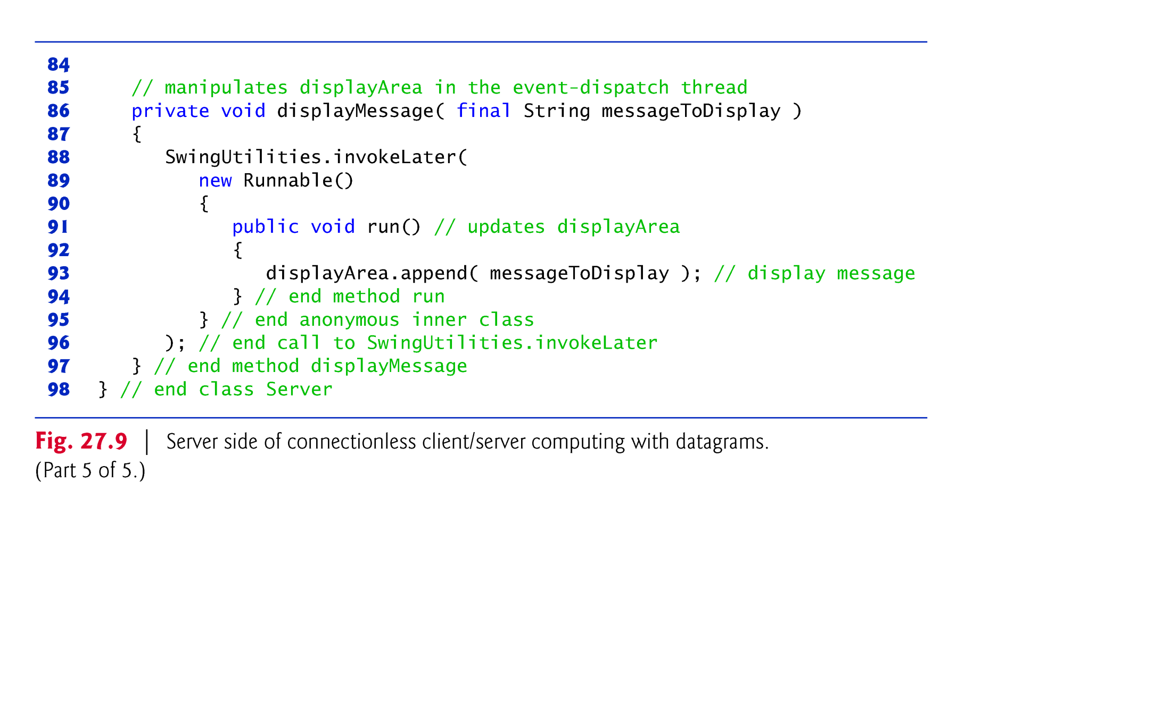

Slide 71


Slide 72
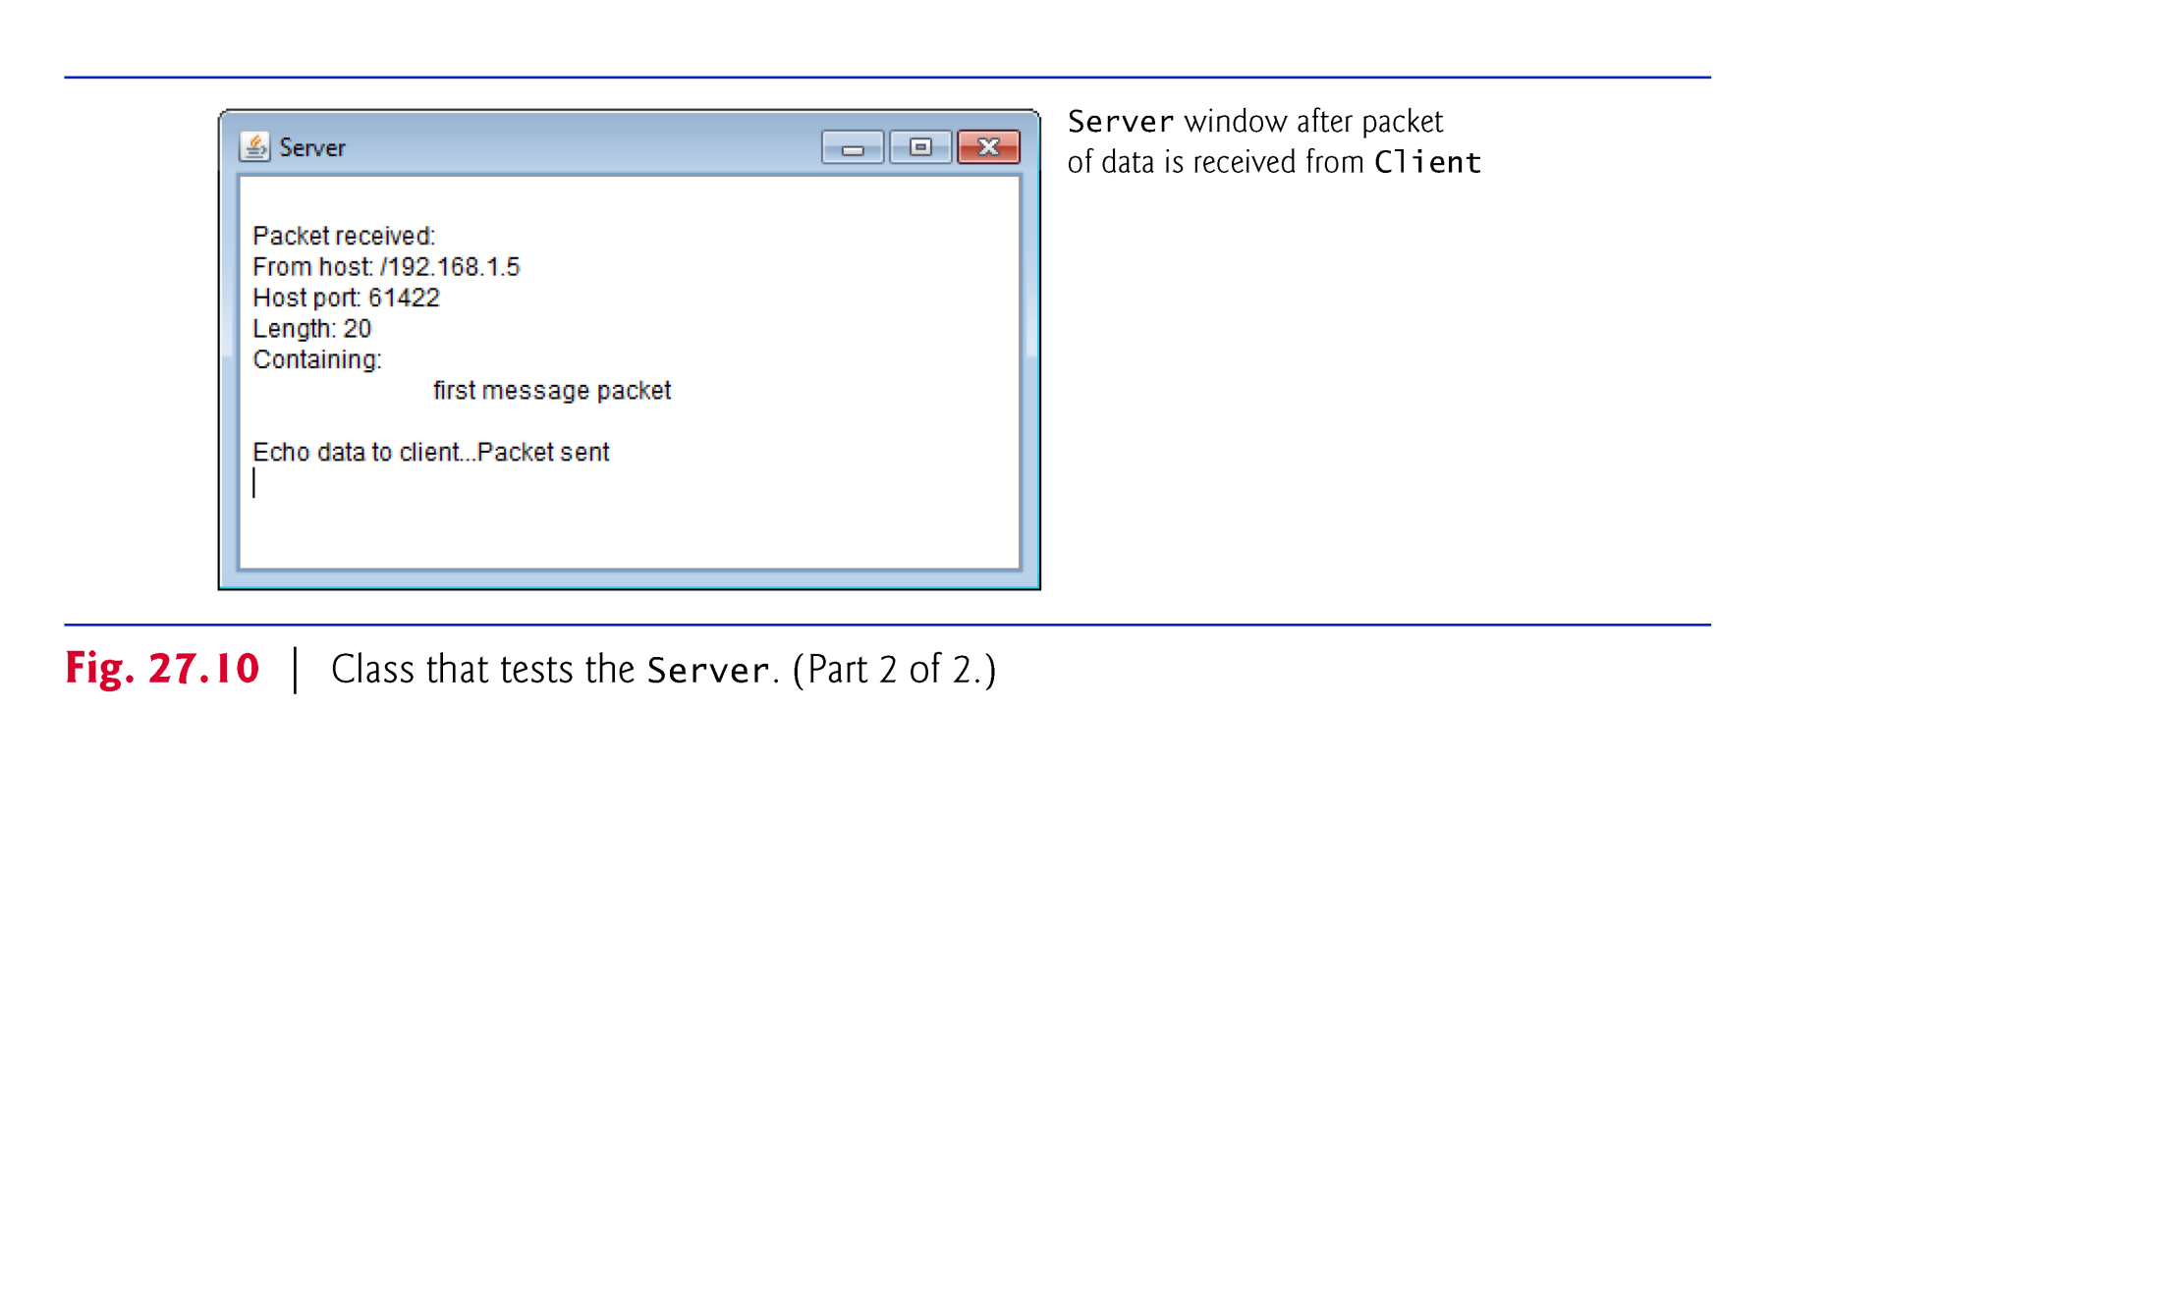

Slide 73
26.7 Connectionless Client/Server Interaction with Datagrams (cont.)
DatagramSocket method receive waits for a packet to arrive at the Server.
Blocks until a packet arrives, then stores the packet in its DatagramPacket argument.
The method throws an IOException if an error occurs while receiving a packet.
DatagramPacket method getAddress returns an InetAddress object containing the IP address of the computer from which the packet was sent.
Method getPort returns an integer specifying the port number through which the client computer sent the packet.
Method getLength returns an integer representing the number of bytes of data received.
Method getData returns a byte array containing the data.
DatagramSocket method send throws an IOException if an error occurs while sending a packet.

Slide 74
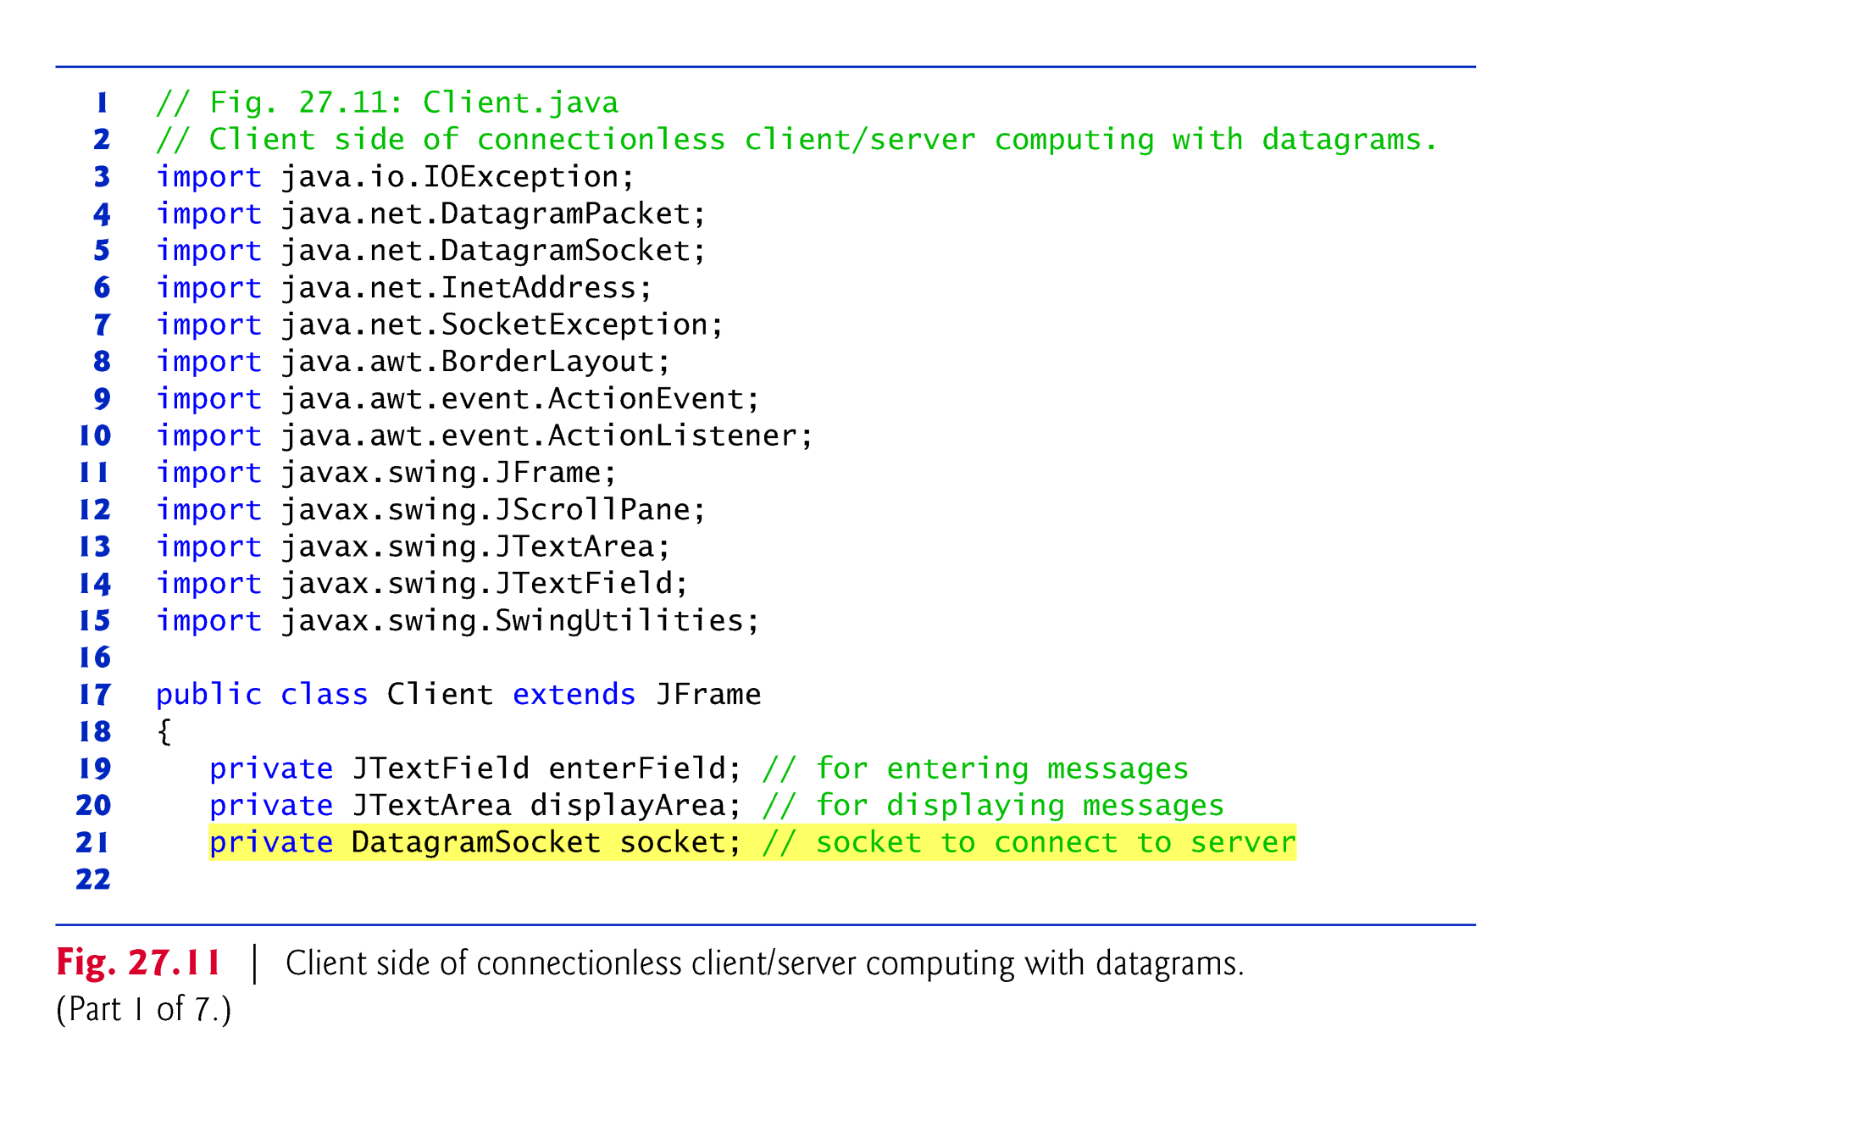

Slide 75
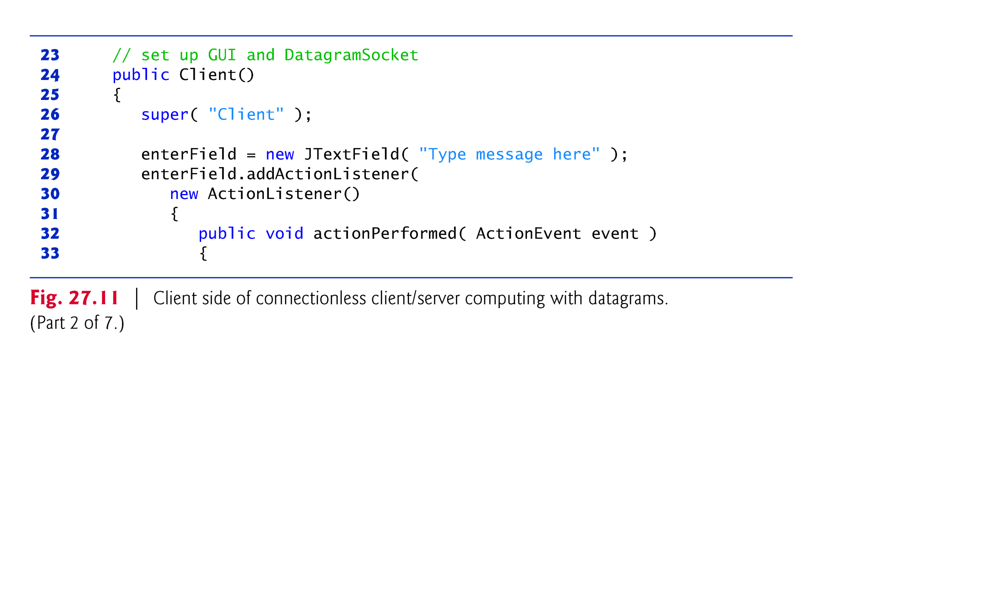

Slide 76


Slide 77


Slide 78


Slide 79


Slide 80


Slide 81


Slide 82


Slide 83
26.8 Client/Server Tic-Tac-Toe Using a Multithreaded Server
Tic-Tac-Toe implemented by using client/server techniques with stream sockets.
Sample outputs are shown in Fig. 27.17.
As the TicTacToeServer receives each client connection, it creates an instance of inner-class Player to process the client in a separate thread.
These threads enable the clients to play the game independently.
The first client to connect to the server is player X and the second is player O.
Player X makes the first move.
The server maintains the information about the board so it can determine if a player’s move is valid.

Slide 84


Slide 85


Slide 86


Slide 87


Slide 88


Slide 89


Slide 90


Slide 91


Slide 92


Slide 93


Slide 94


Slide 95


Slide 96


Slide 97


Slide 98


Slide 99


Slide 100


Slide 101


Slide 102


Slide 103
26.8 Client/Server Tic-Tac-Toe Using a Multithreaded Server (cont.)
When a client connects, a new Player object is created to manage the connection as a separate thread, and the thread is executed in the runGame thread pool.
The Player constructor receives the Socket object representing the connection to the client and gets the associated input and output streams.
The Player’s run method controls the information that is sent to and received from the client.

Slide 104


Slide 105


Slide 106


Slide 107


Slide 108


Slide 109


Slide 110


Slide 111


Slide 112


Slide 113


Slide 114


Slide 115


Slide 116


Slide 117


Slide 118


Slide 119


Slide 120


Slide 121


Slide 122


